Slide 2
Mission To educate, advocate, and agitate for renewable energy, pure water, clean air, and a healthy sustainable environment for future generations.

Slide 3
In April 2012, eleven women, mostly strangers to one another, sat down to dinner at the invitation of Barbara Schlachter of Iowa City. By the end of the evening, this group rose up as the foundation of 100Grannies. Sadly, Barbara is no longer with us, but we continue our efforts to fulfill her legacy.

Slide 4
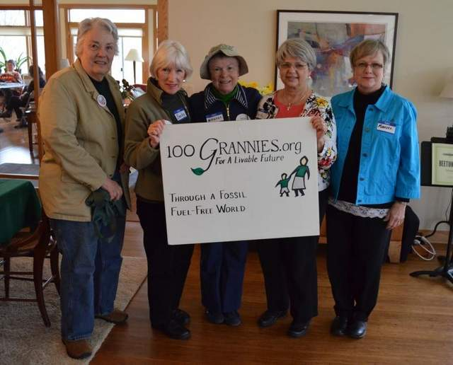
Some of our founders

Slide 5
Since that time, we have continued to grow, both locally and nationally. Our foremost goal is to provide a livable future for children and grandchildren the world round.

Slide 6
We are united to reverse global warming and to halt the climate crisis.

Slide 7
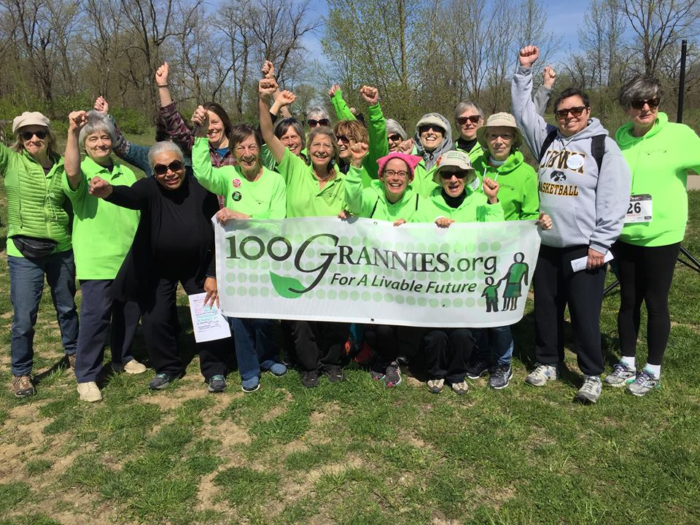
Earth Day March

Slide 8
Educate. Advocate. Agitate.

Slide 9
Fall film series Featuring four films or videos on climate issues state, nation, and worldwide. Spring lecture series: Four local experts focus on local, state, and national issues.
We educate.

Slide 10
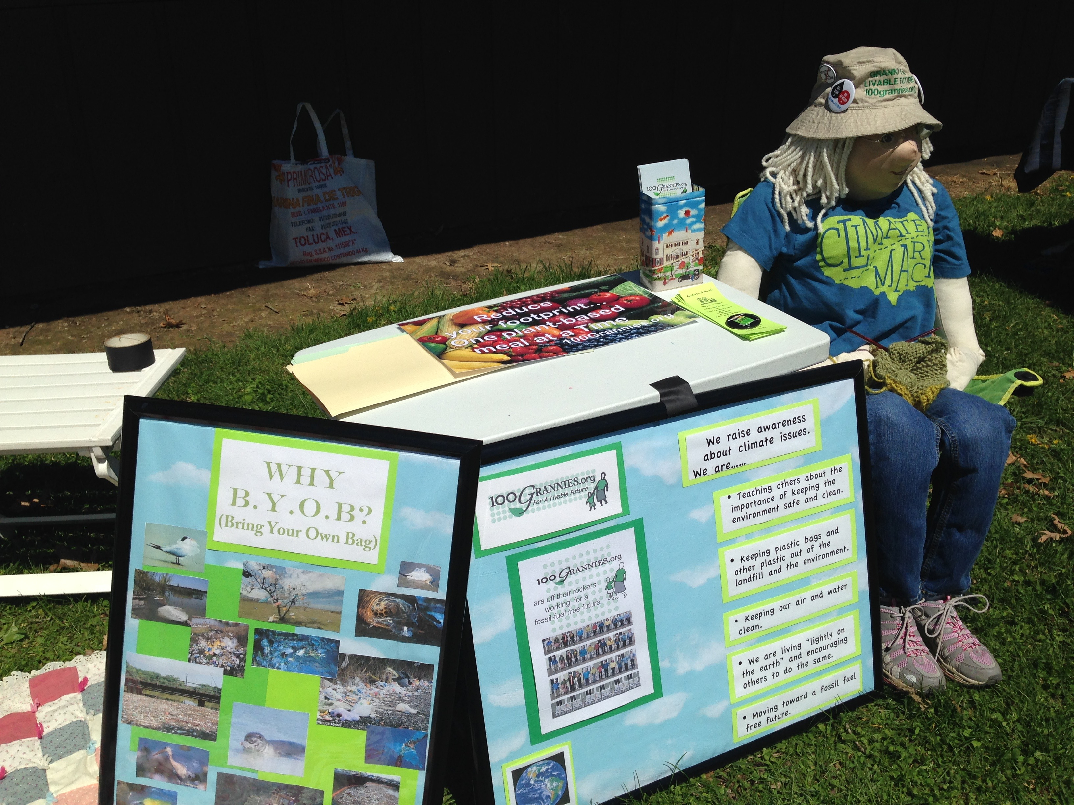
Participating in Earth Day events

Slide 11
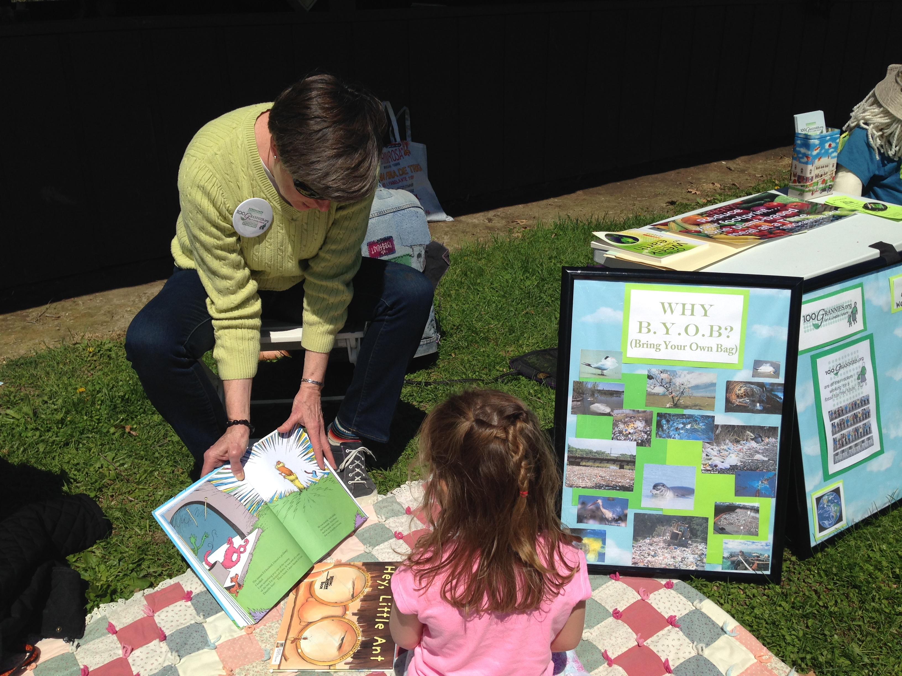
Reading to children

Slide 12
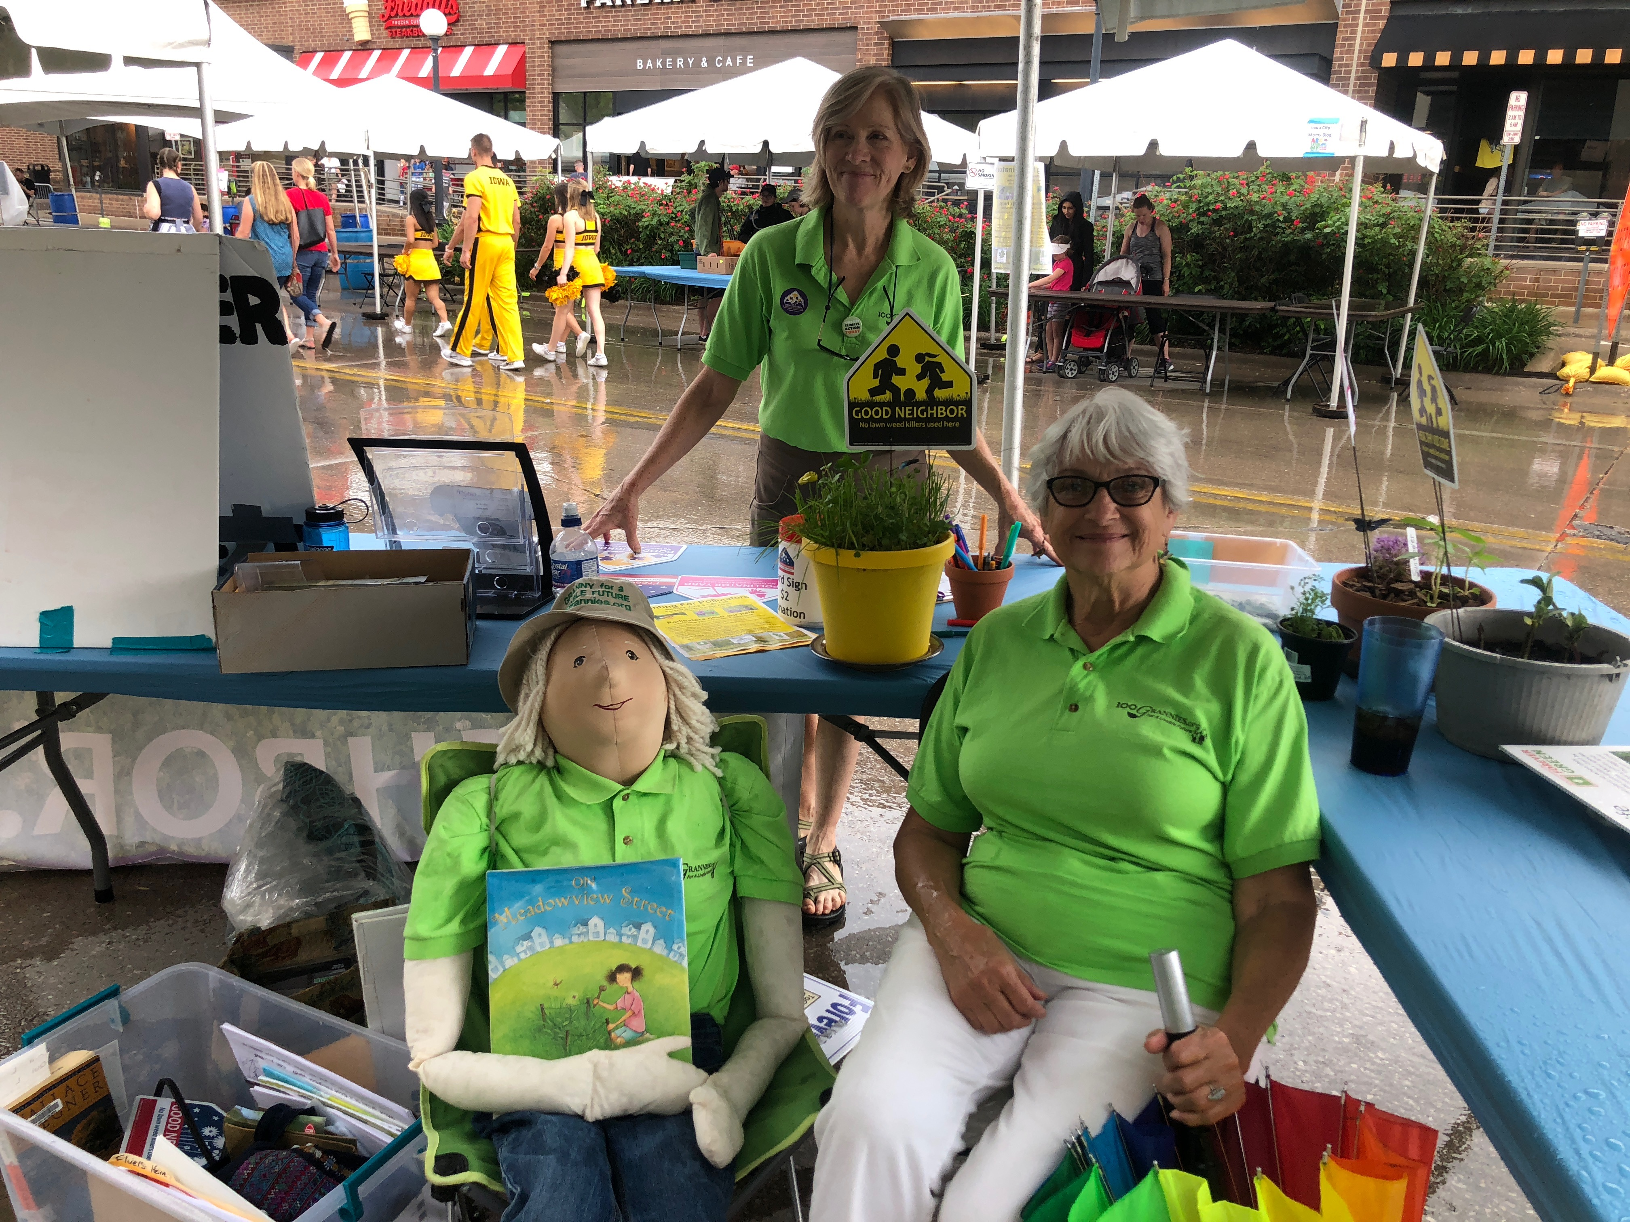
Being a Good Neighbor - pesticide free yards and parks

Slide 13
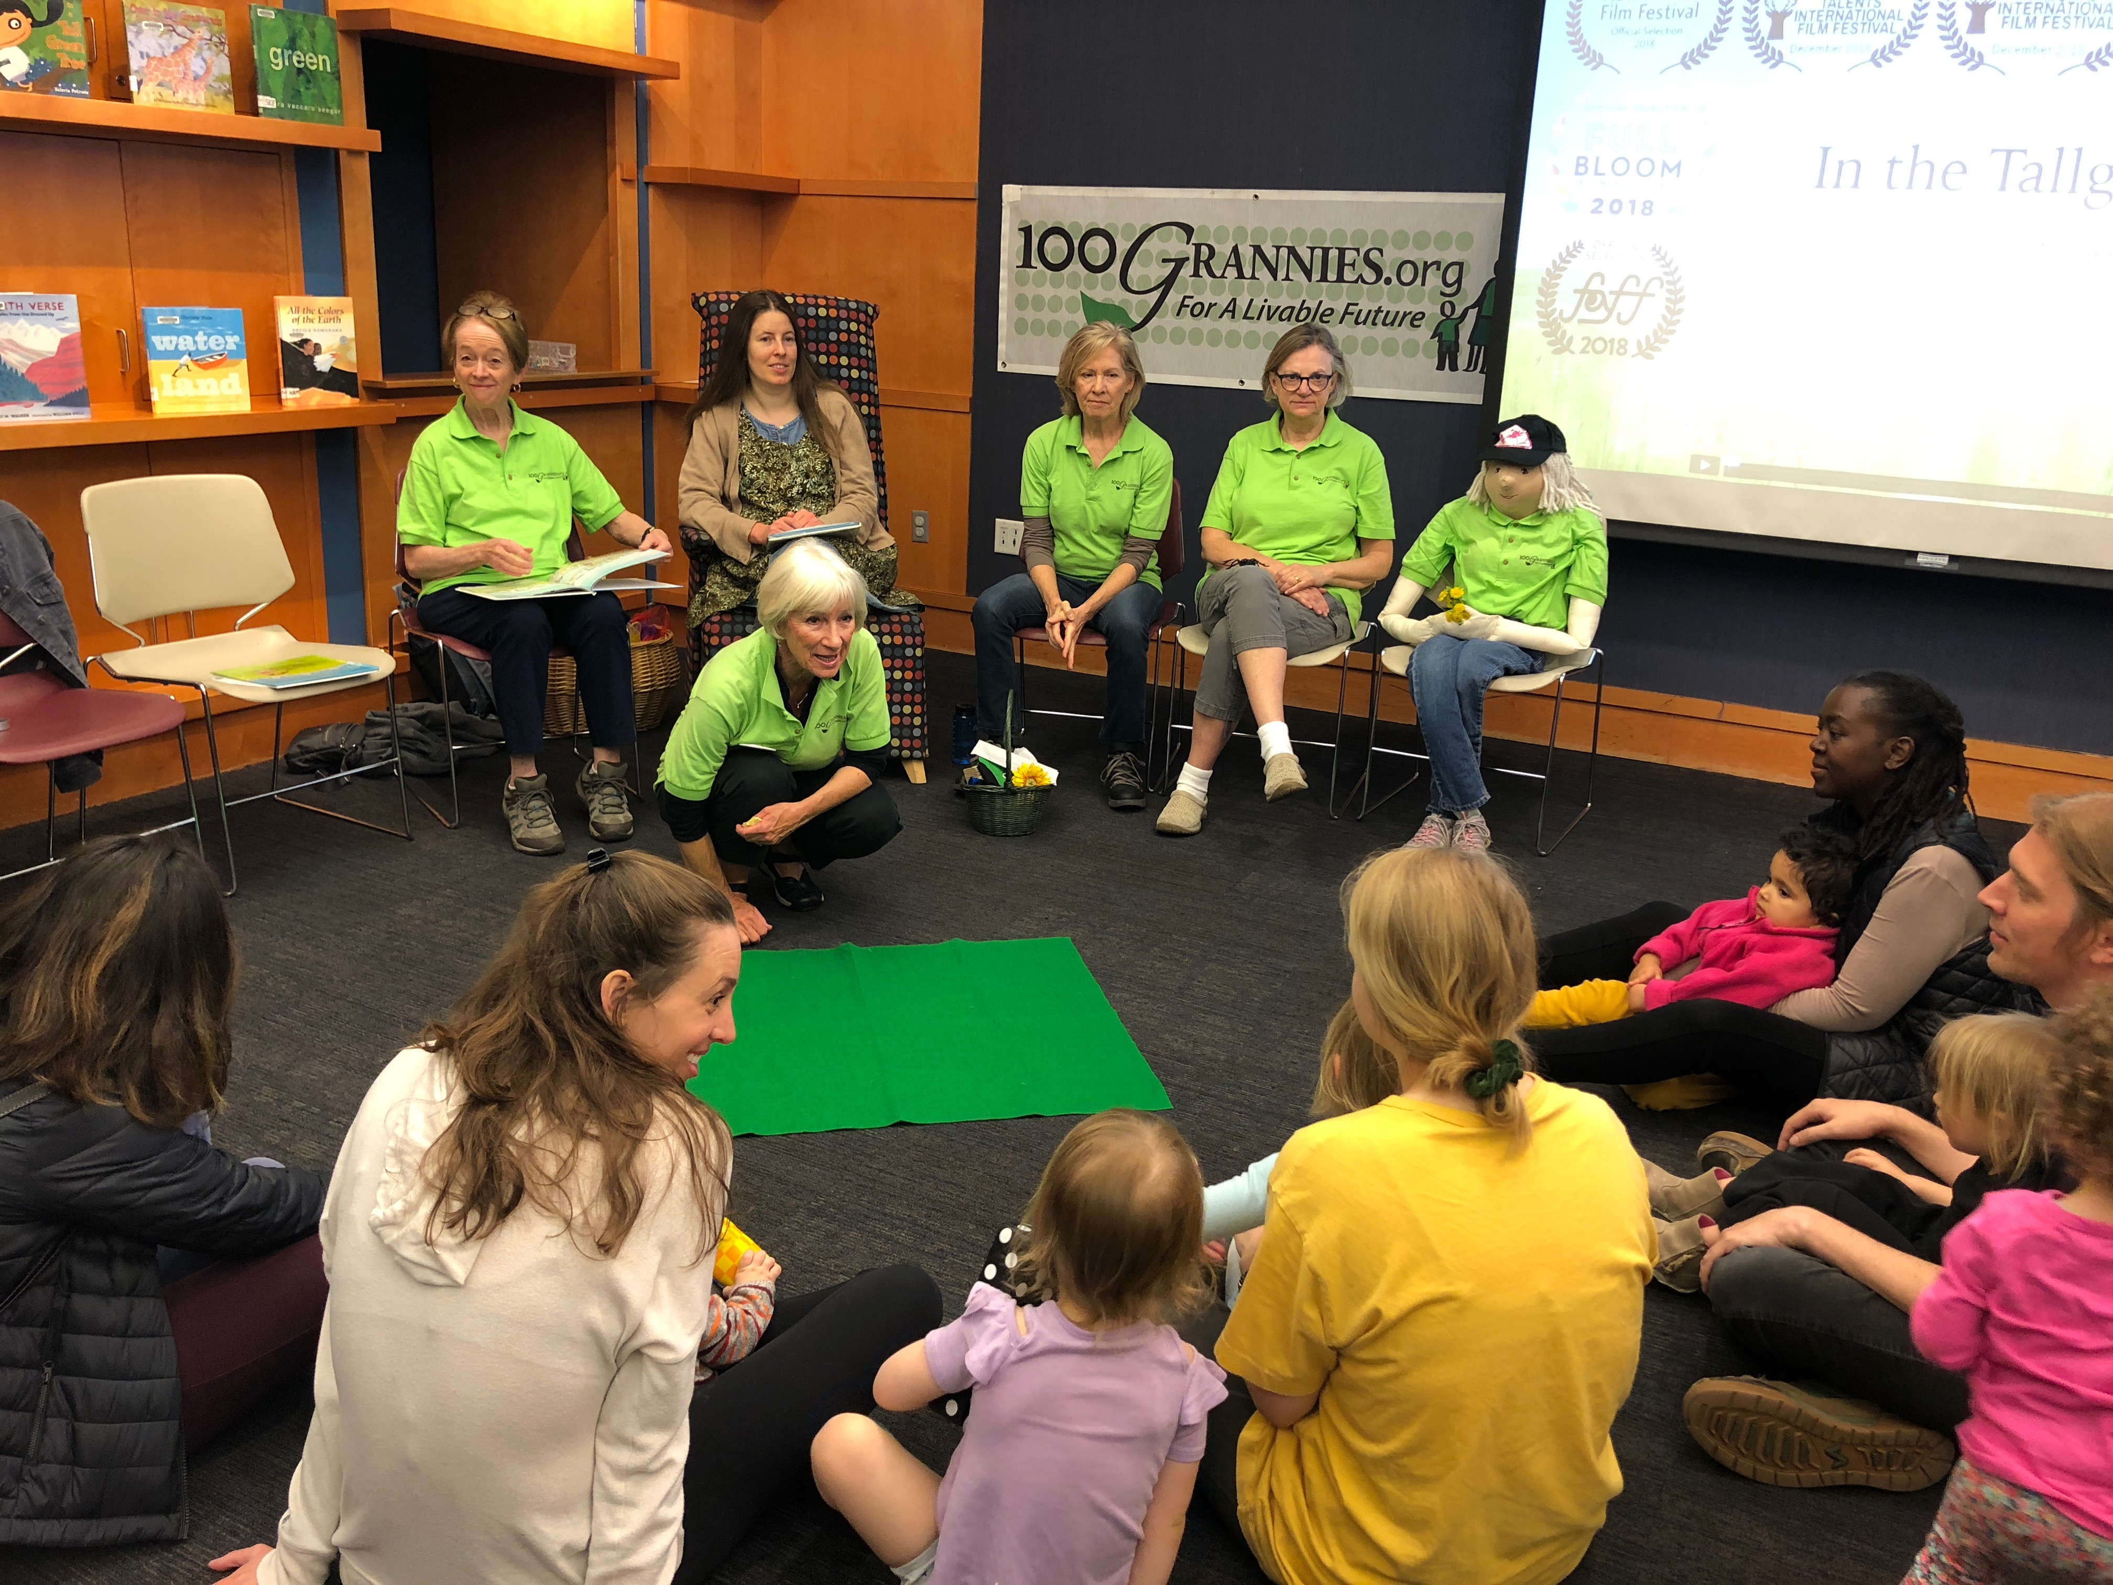
Presenting story time at the Iowa City Public Library

Slide 14
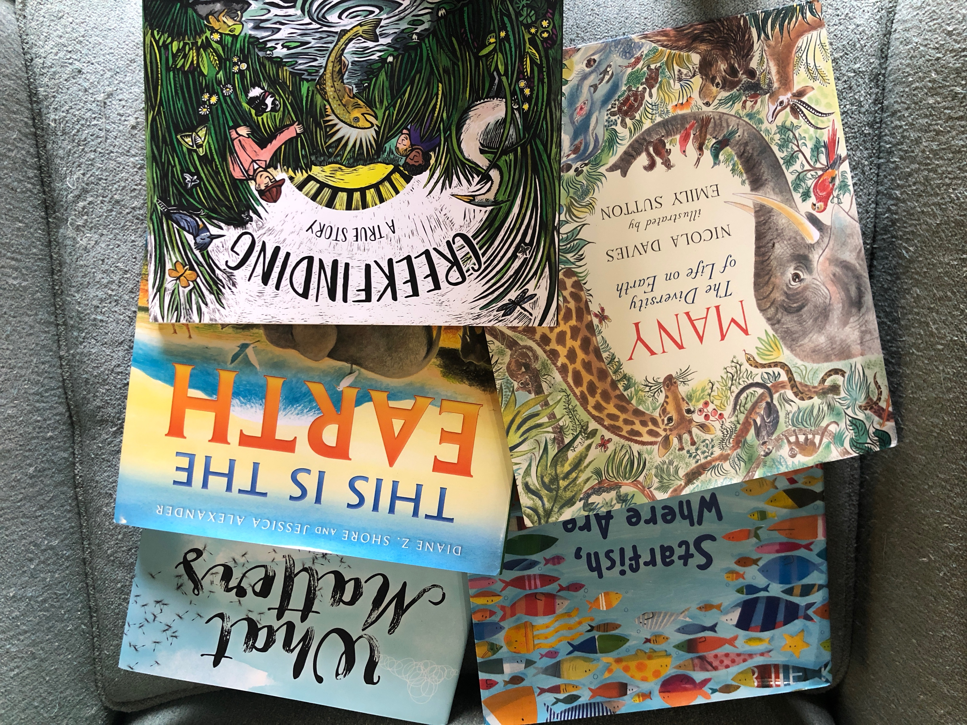
Donating Books to ICCSD

Slide 15
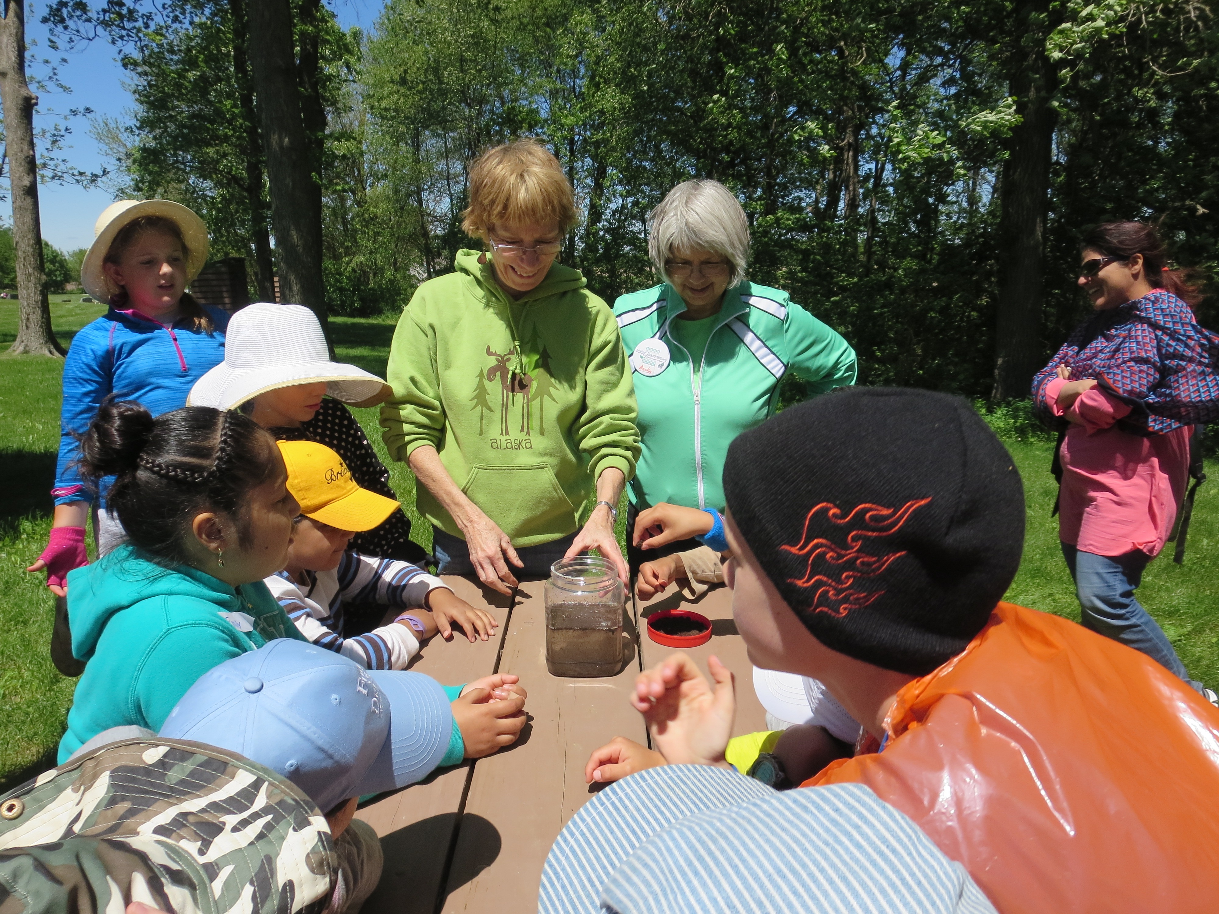
Teaching children about the river

Slide 16
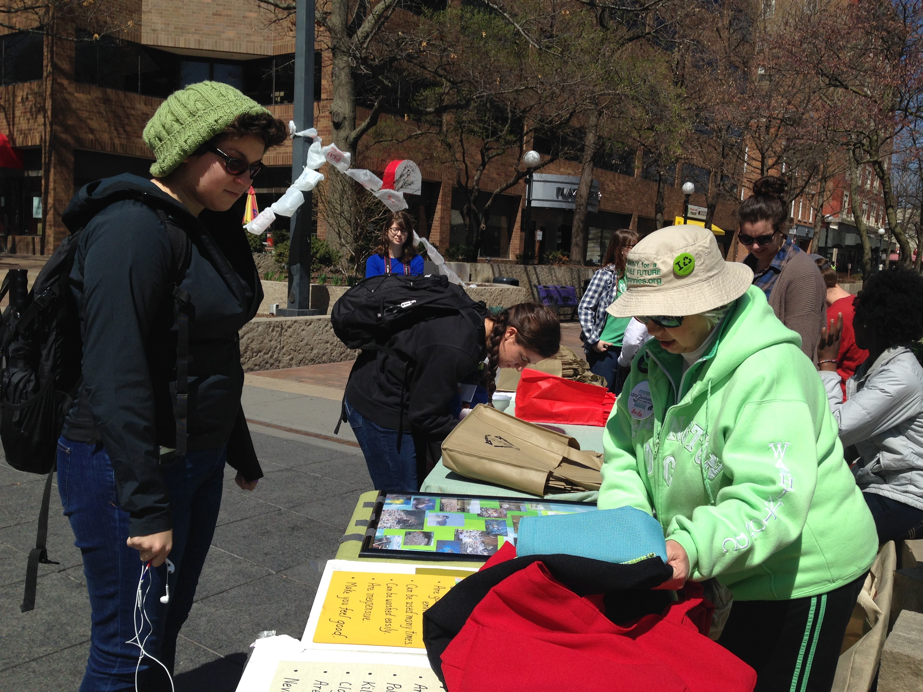
Eliminating single use plastic bags

Slide 17
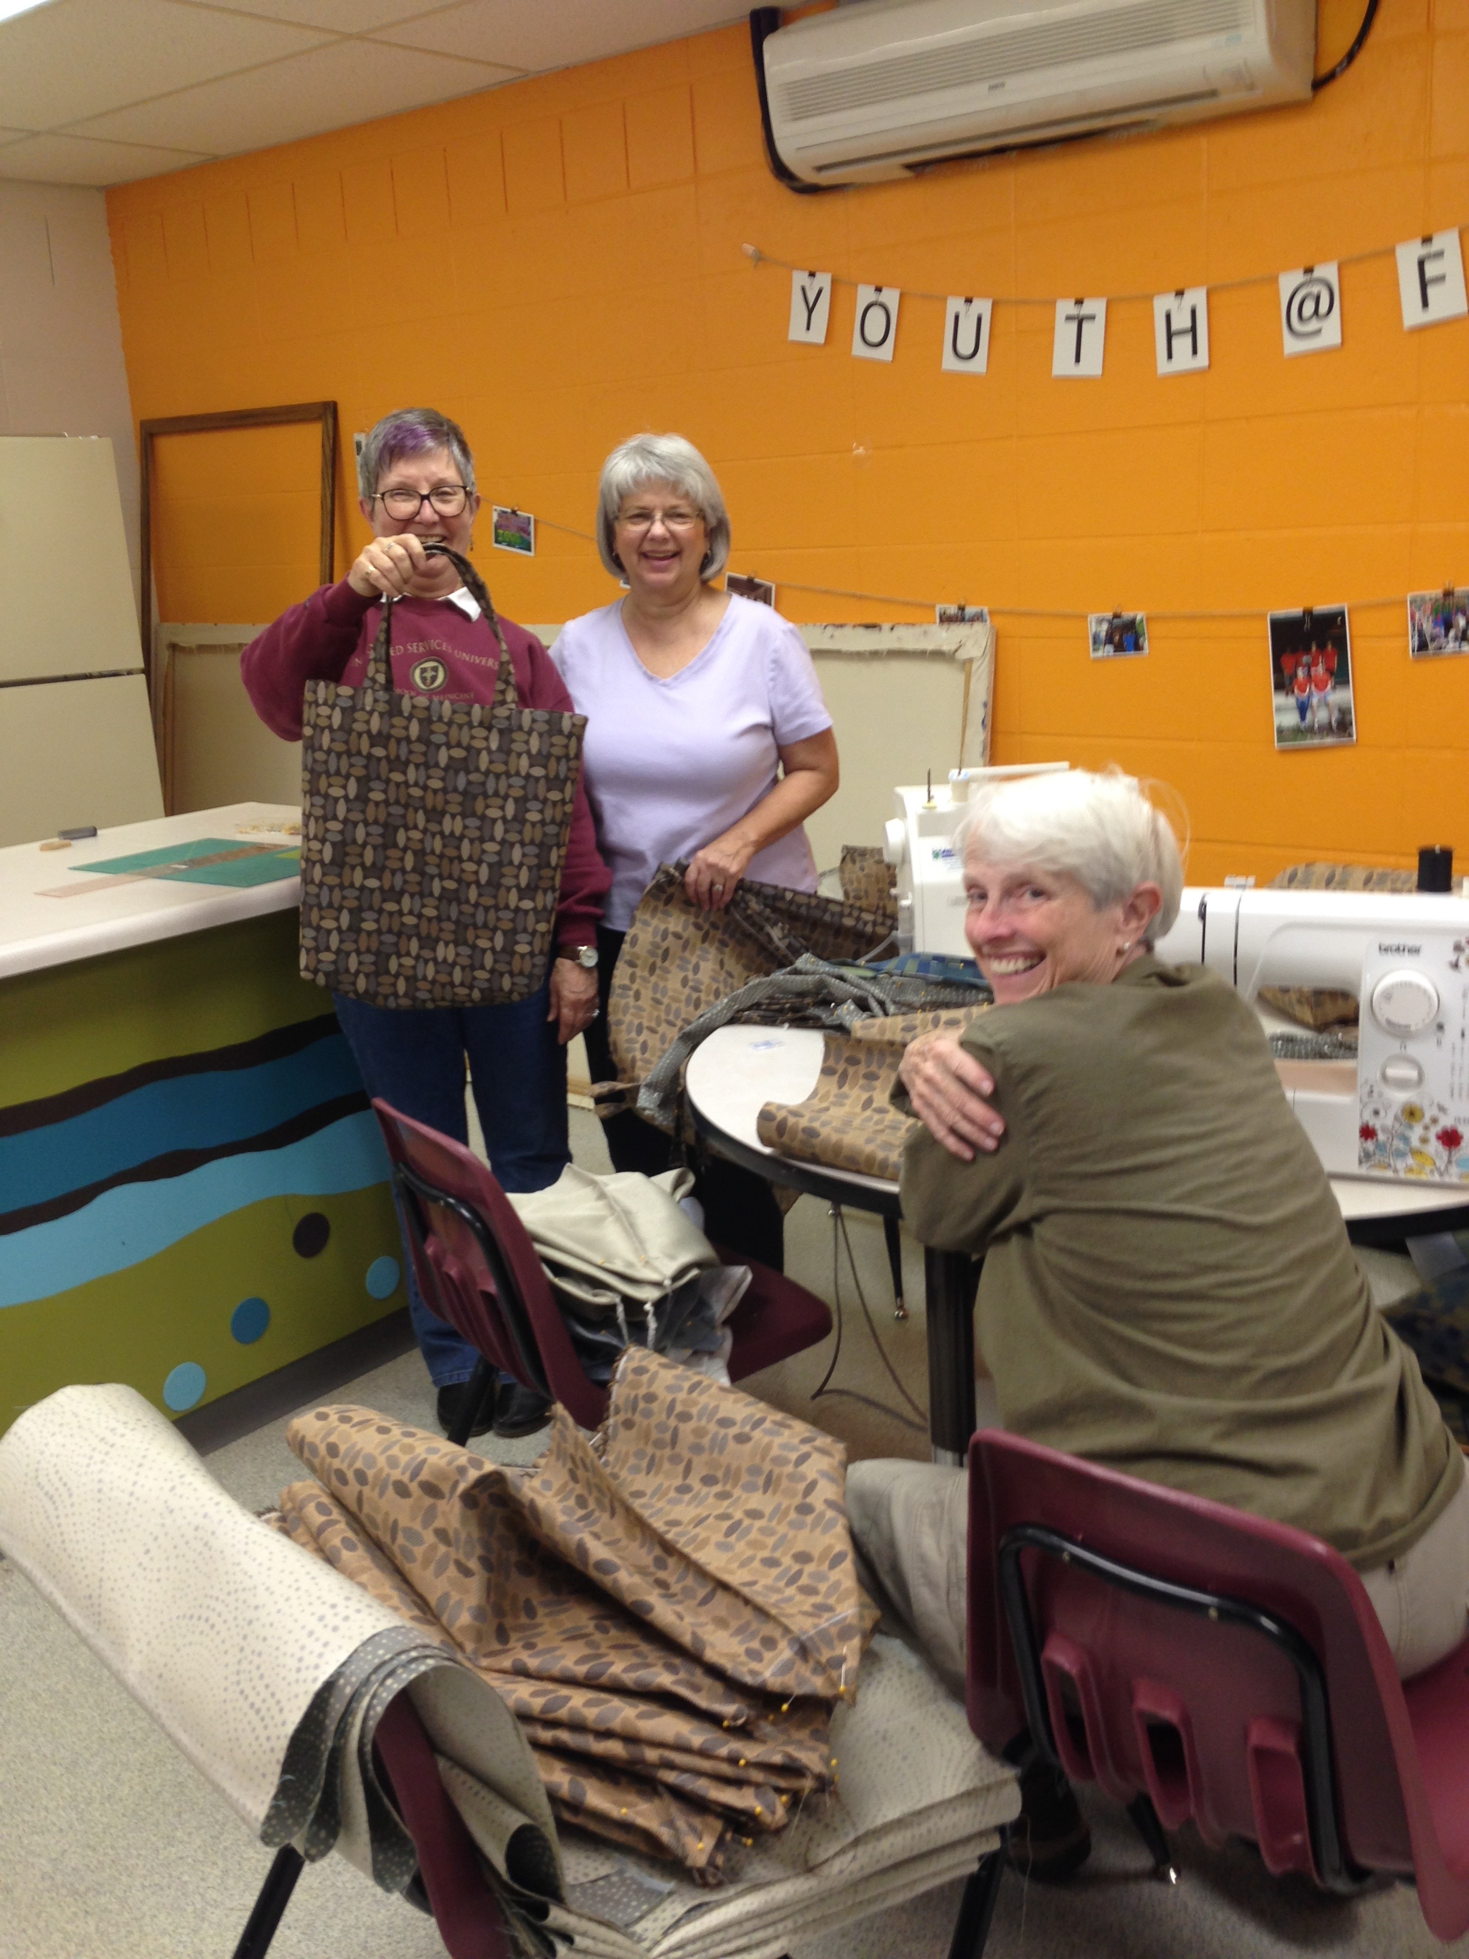
Sewing cloth bags

Slide 18
We have lobbied, and continue to lobby, our elected officials – local, state and federal – on climate issues.
We advocate.

Slide 19
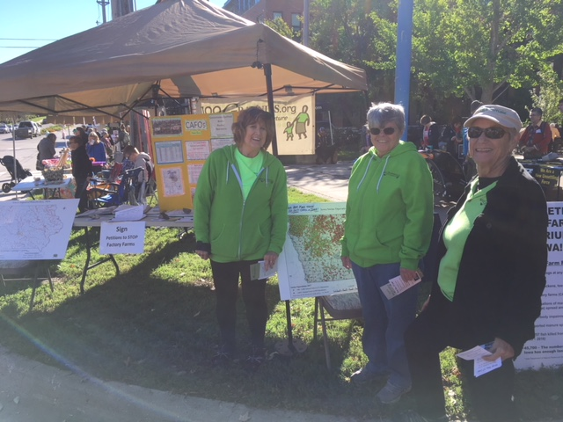
Supporting a CAFO moratorium

Slide 20
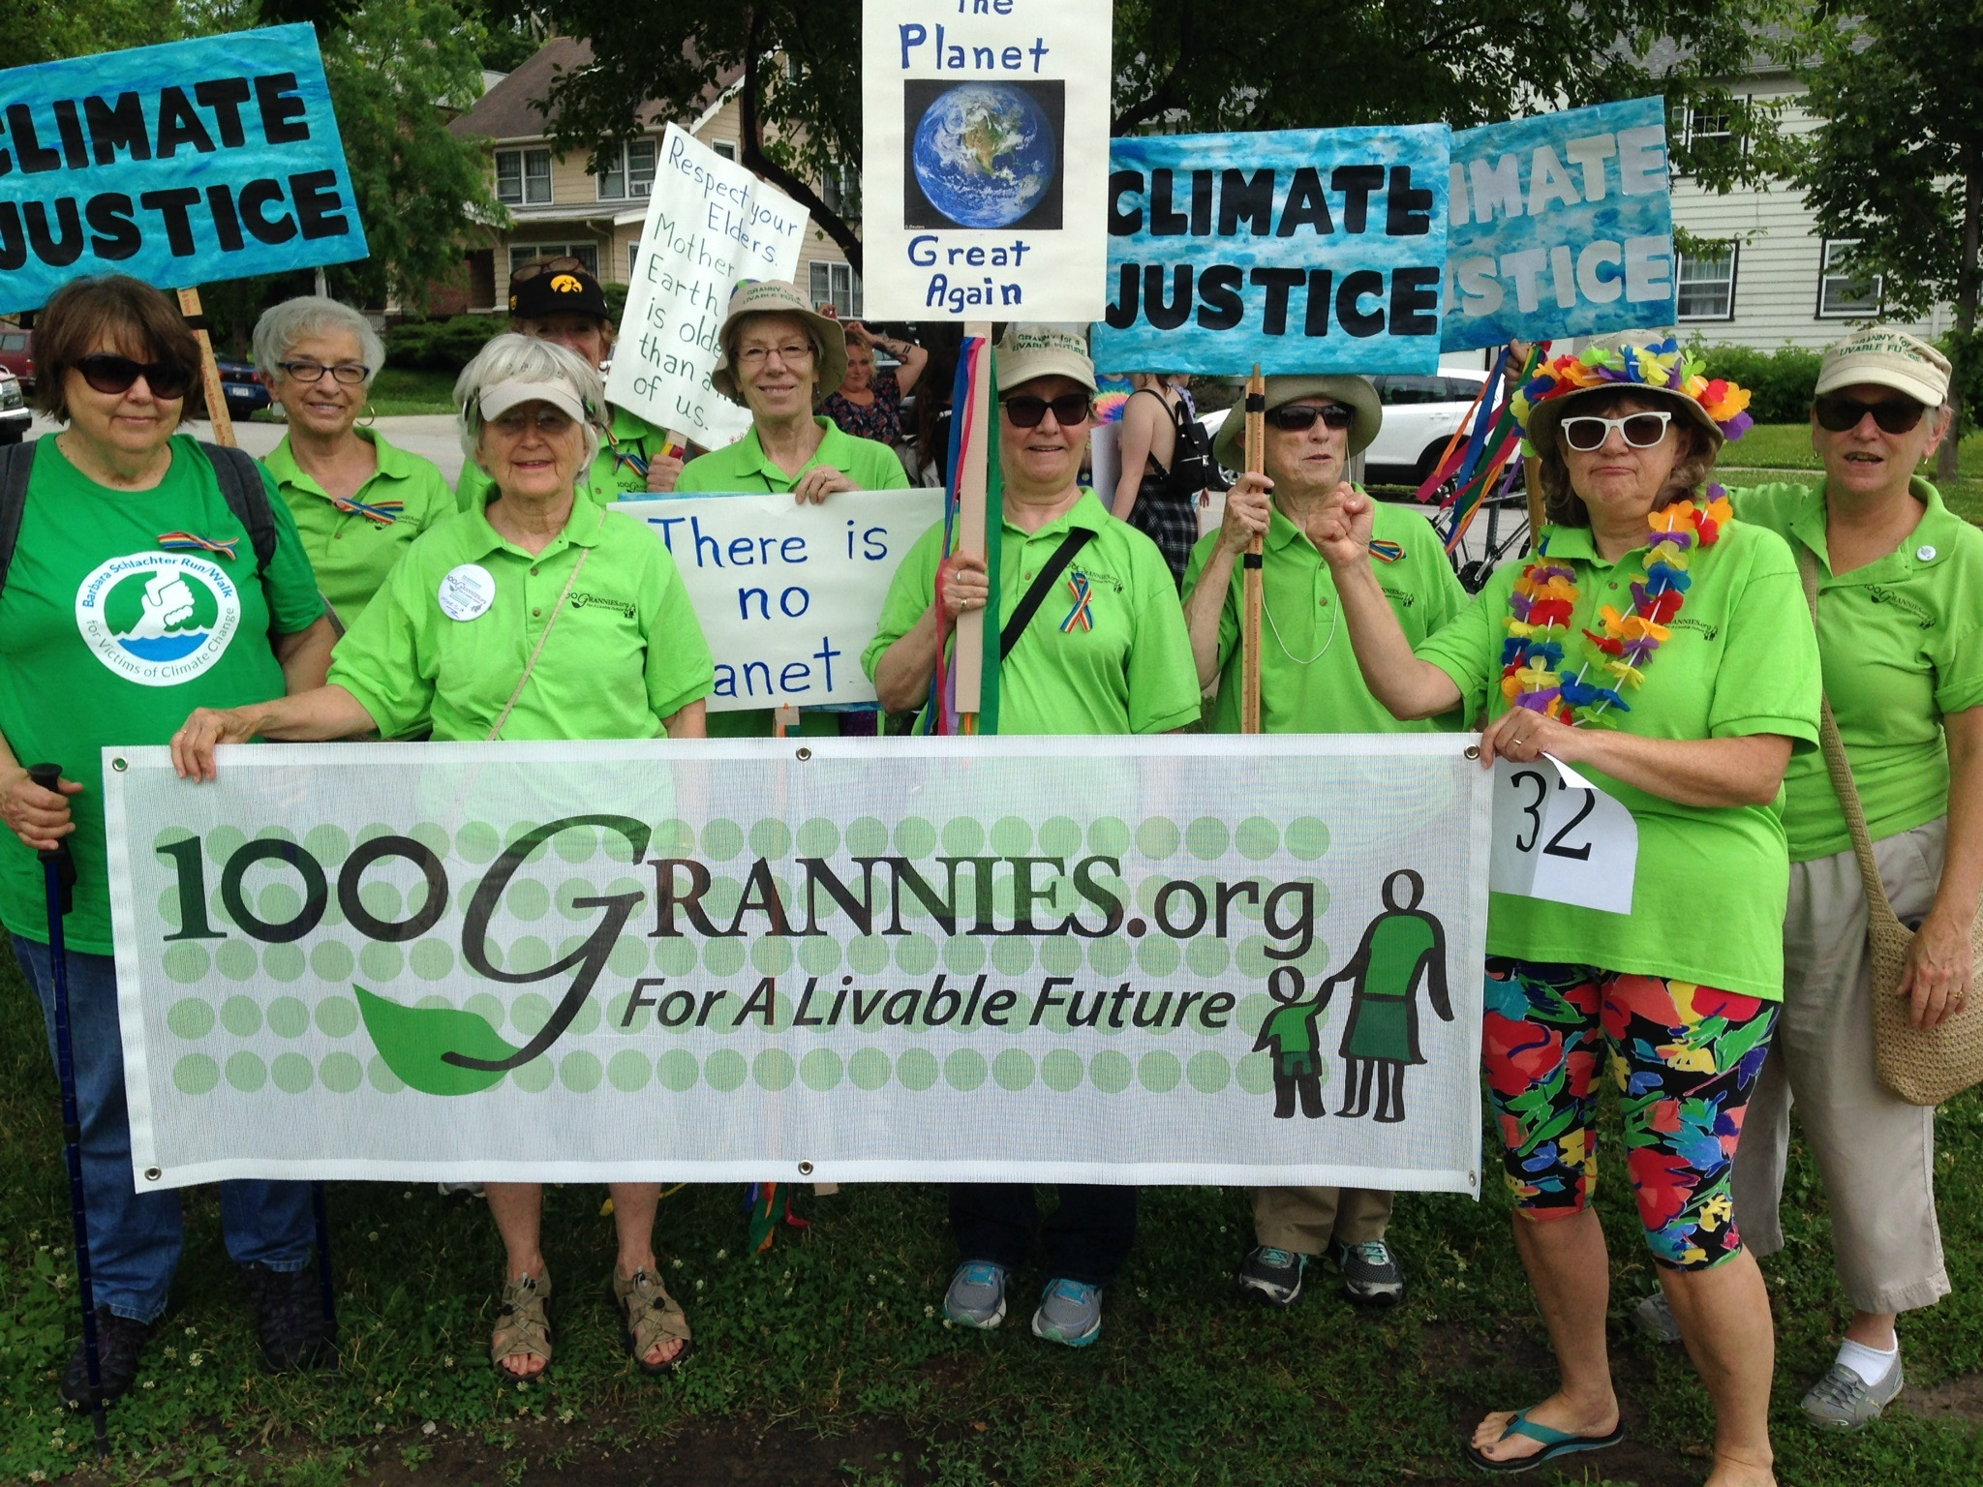
Marching in parades

Slide 21
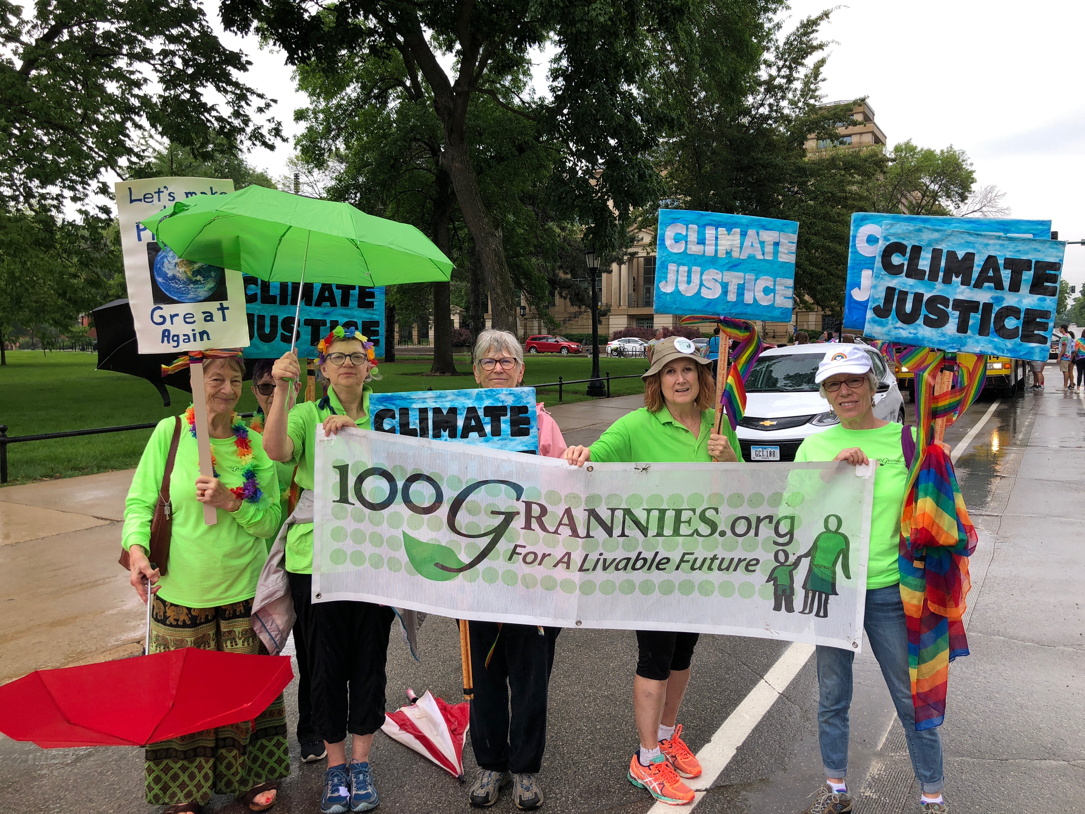
And more parades .

Slide 22
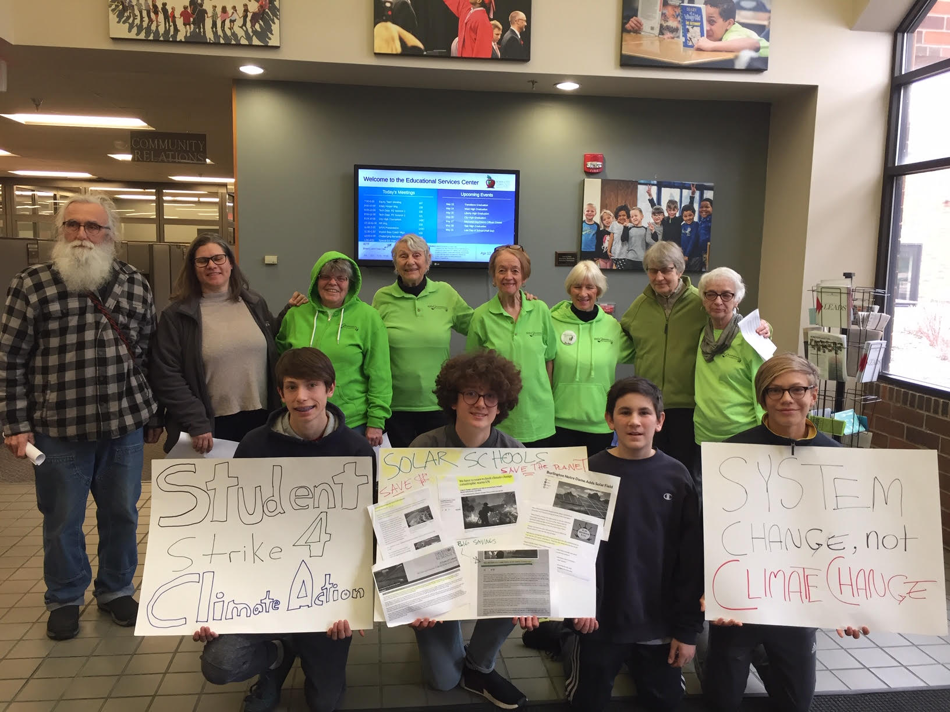
Supporting the student climate strikers t

Slide 23
Standing with Greta

Slide 24
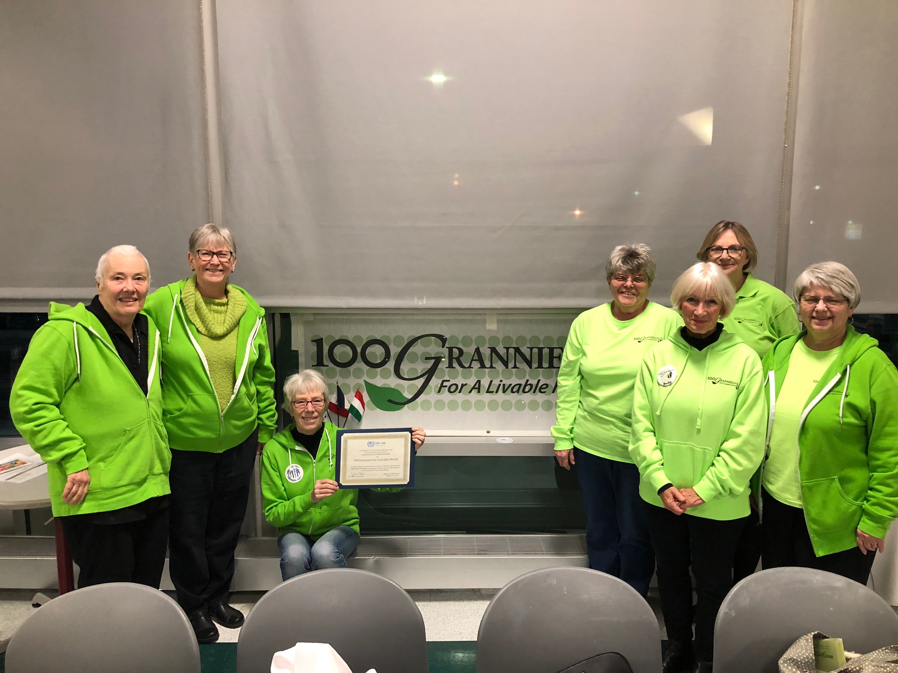
Being acknowledged by the U.N.

Slide 25
Peacefully protesting Fighting the Bakken Pipeline
We agitate.

Slide 26
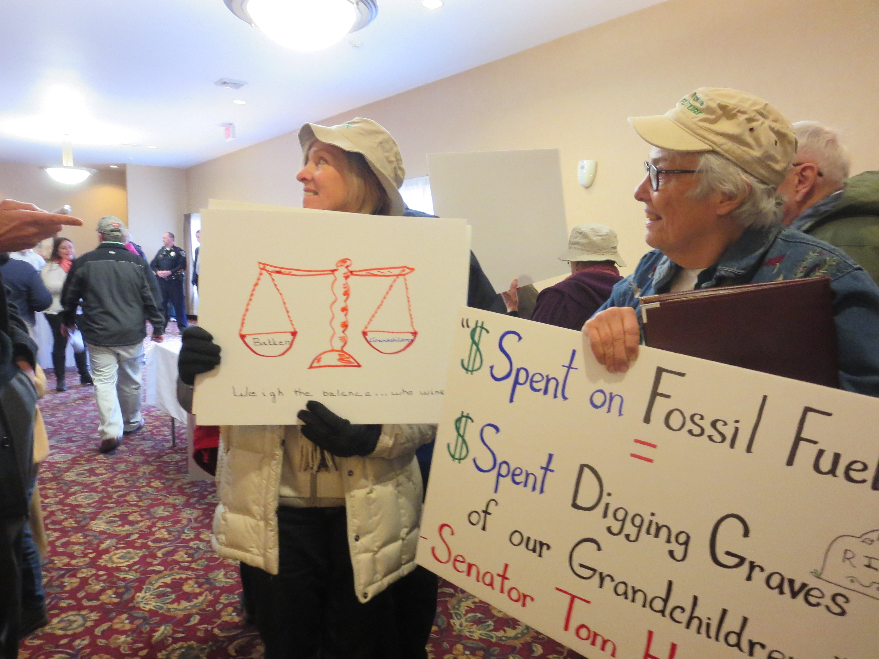
speaking
Fighting the Bakken pipeline.

Slide 27
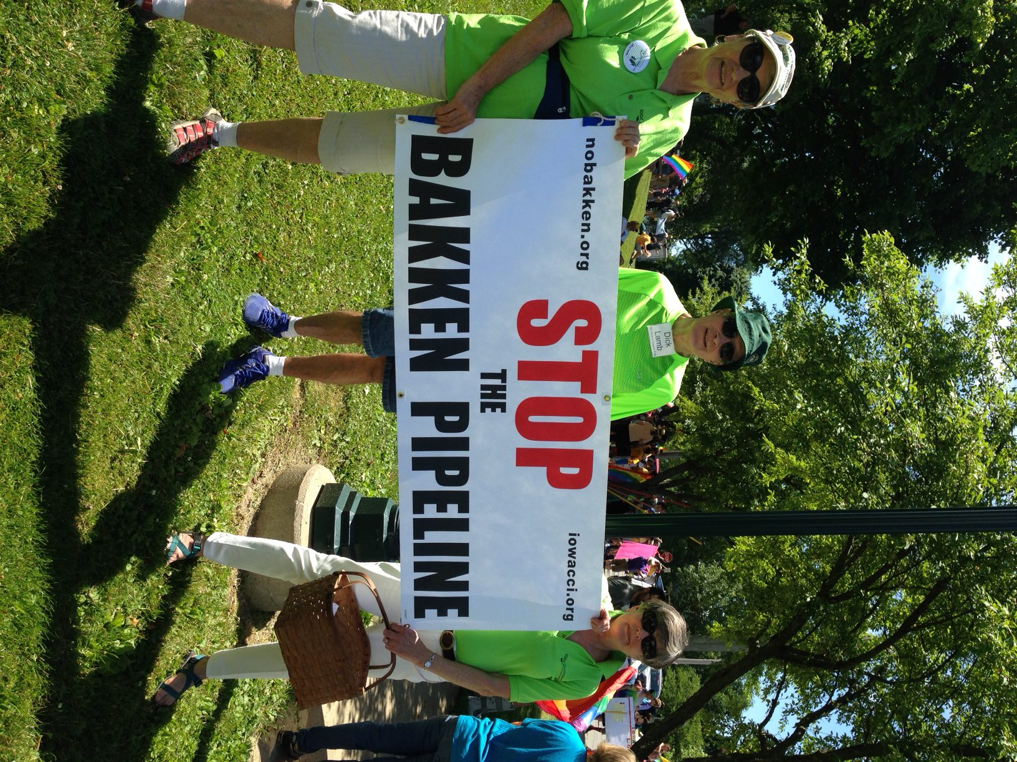
Fighting the Bakken Pipeline

Slide 28
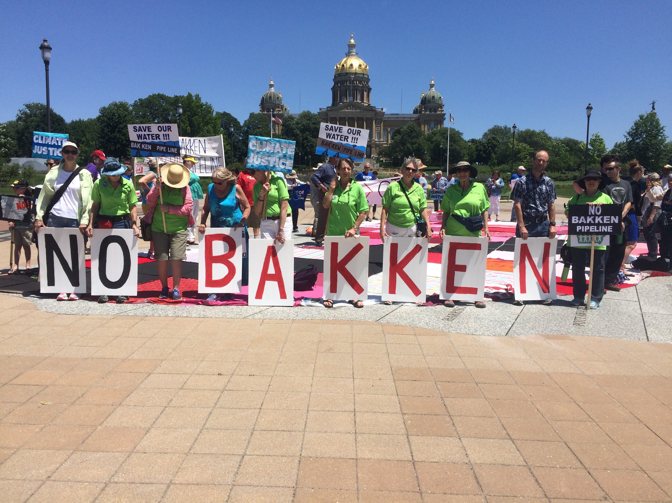
Still fighting the Bakken Pipeline

Slide 29
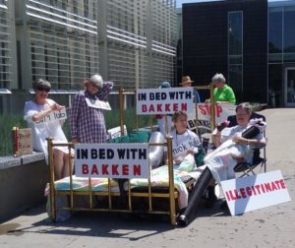
Street Theater in Des Moines

Slide 30
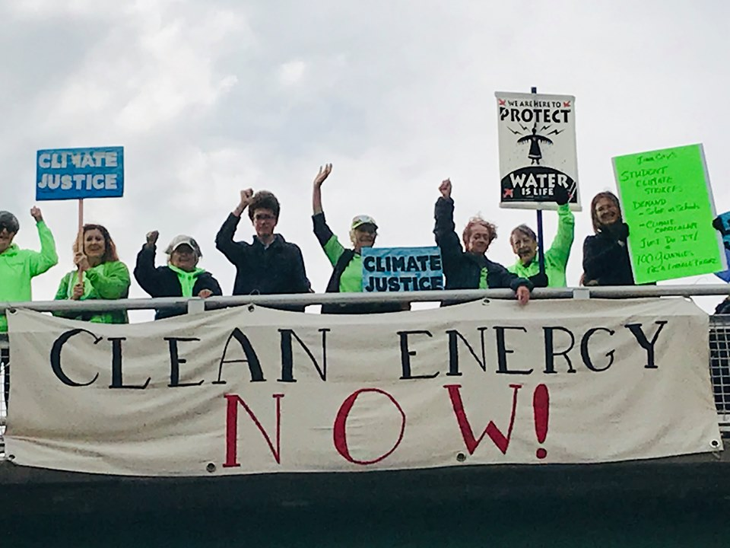
Doing banner Drops

Slide 31
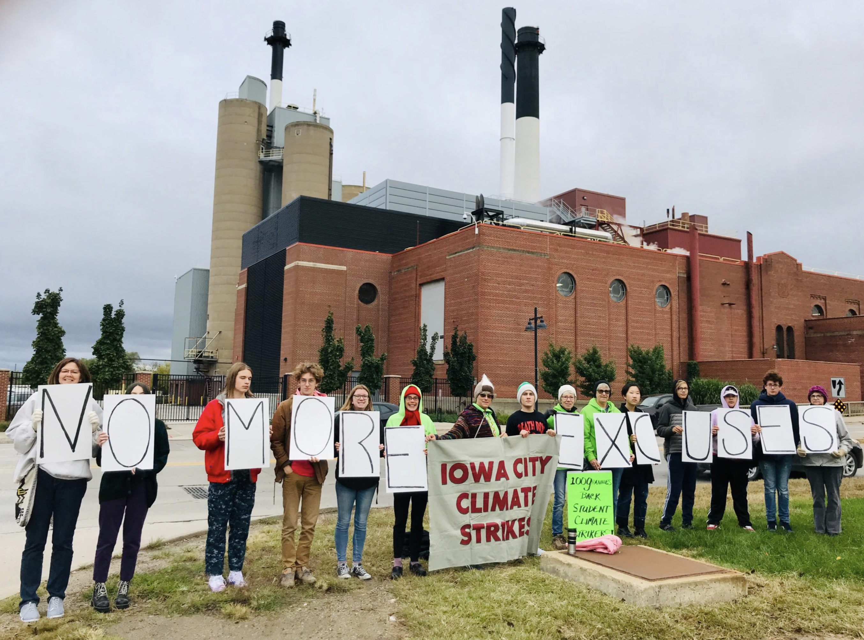
Standing with the student strikers

Slide 32
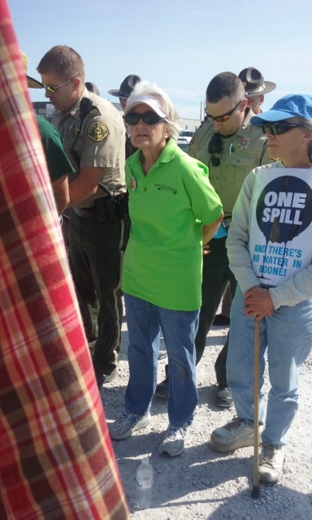
Protesting peacefully and being arrested.

Slide 33
What can you do?
Be educated on global warming and climate change. (i.e. Drawdown)
Join a climate advocacy group
Advocate for effective climate legislation from your local, state, and federal government officials

Slide 34
What can you do at home?
4. Learn how your individual choices can impact the environment, for example:
1. Eat a plant rich diet
2. Support women’s education and family planning worldwide
3. Drive less, carpool, walk, and bike more
4. Avoid buying plastic

Slide 35
100Grannies.org 100Granniesiowacity@gmail.com

