Slide 1
L
Re-imagining Sustainability
L
Sailesh Rao, Executive Director
Climate Healers, Phoenix, AZ, USA

Slide 3
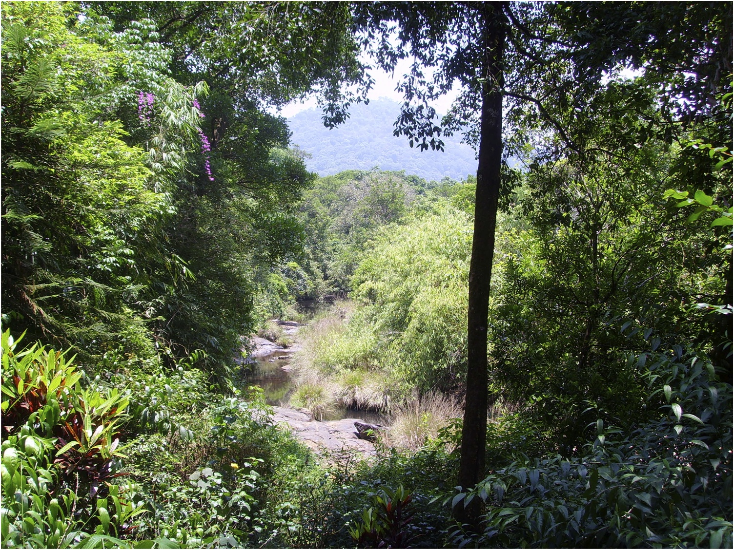

Slide 4
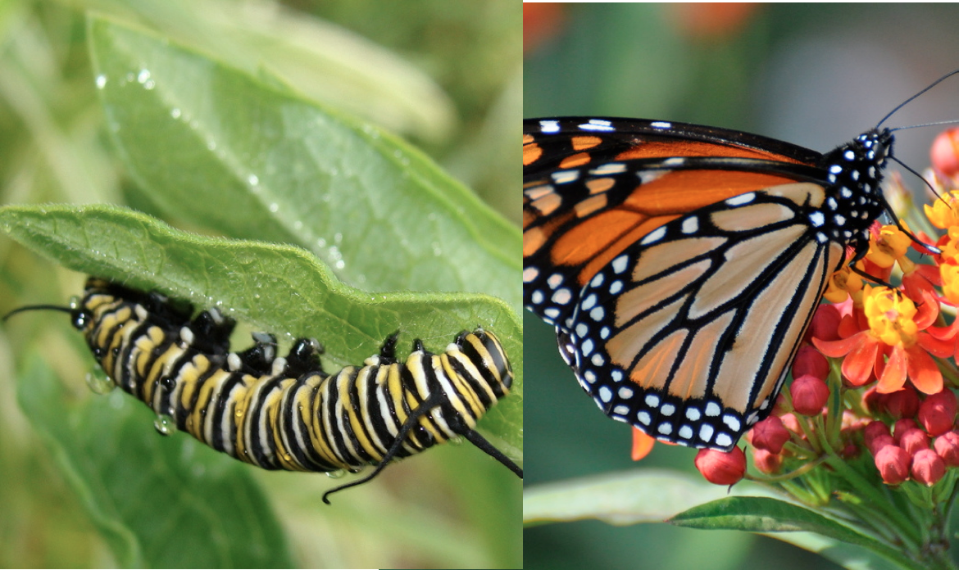

Slide 5
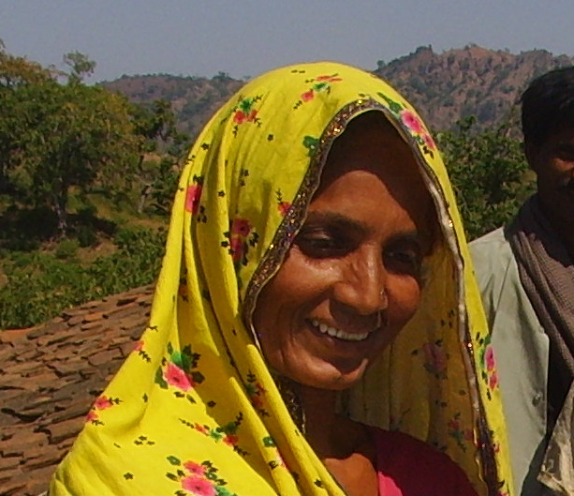

Slide 6
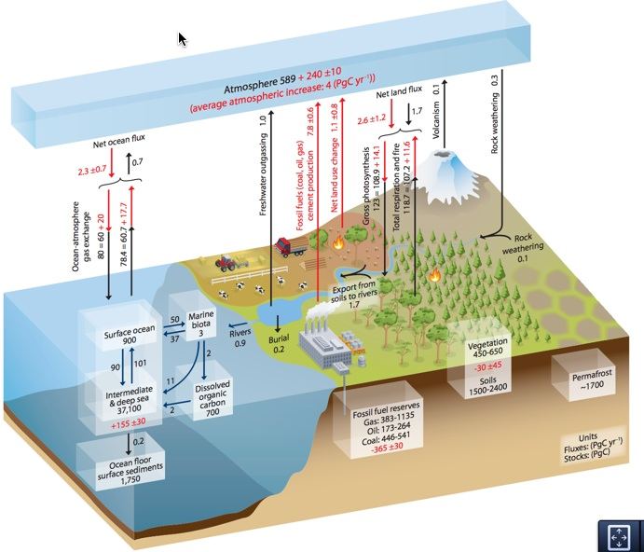
Source: IPCC AR5 WG1 Ch6, Fig.6.1 pg.471

Slide 7
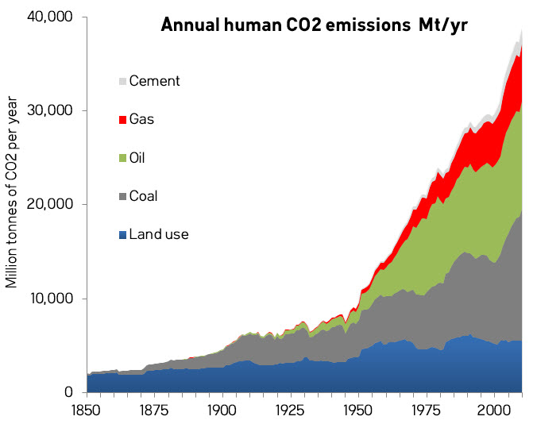
Data from CDIAC, graphics from Andy Skuce, Skeptical Science

Slide 8
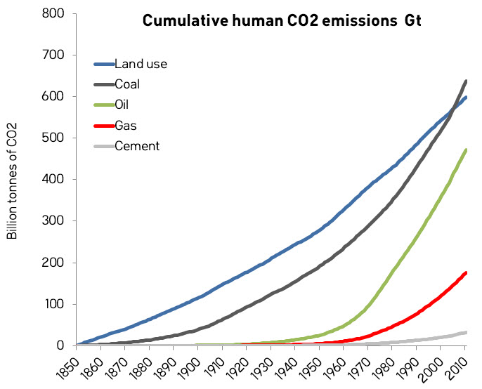
Data from CDIAC, graphics from Andy Skuce, Skeptical Science

Slide 9
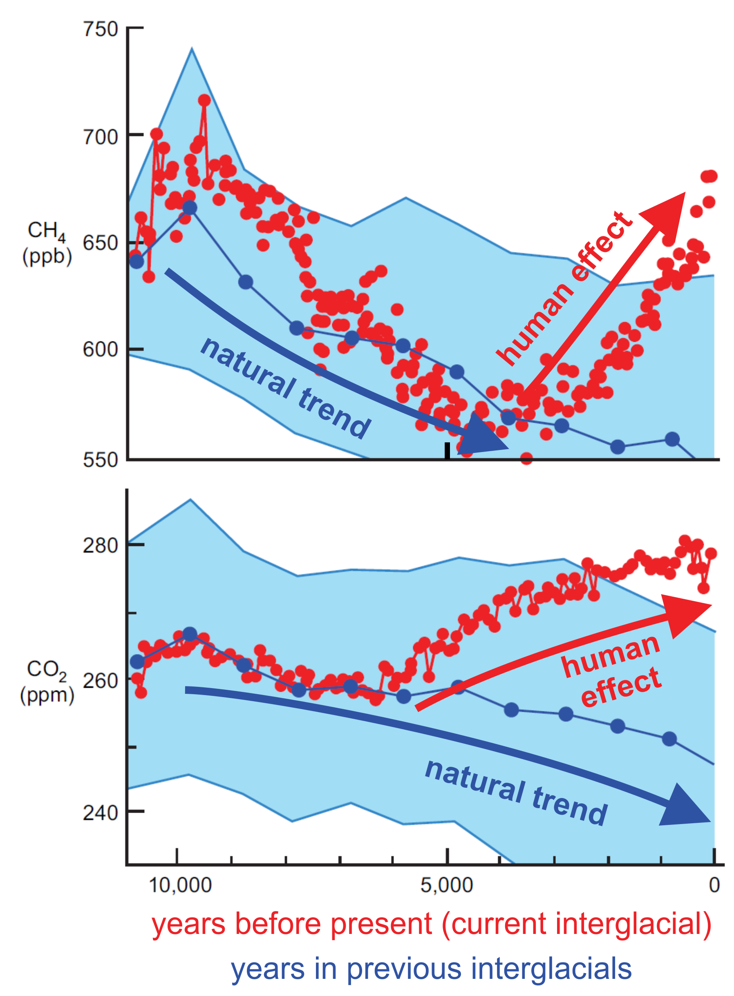
Annotated graphics from William Ruddiman, 2014.

Slide 10
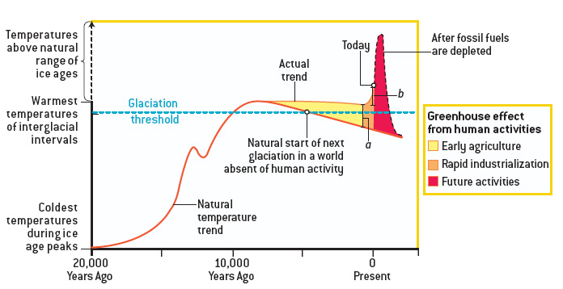
Annotated graphics from William Ruddiman, 2014.

Slide 11
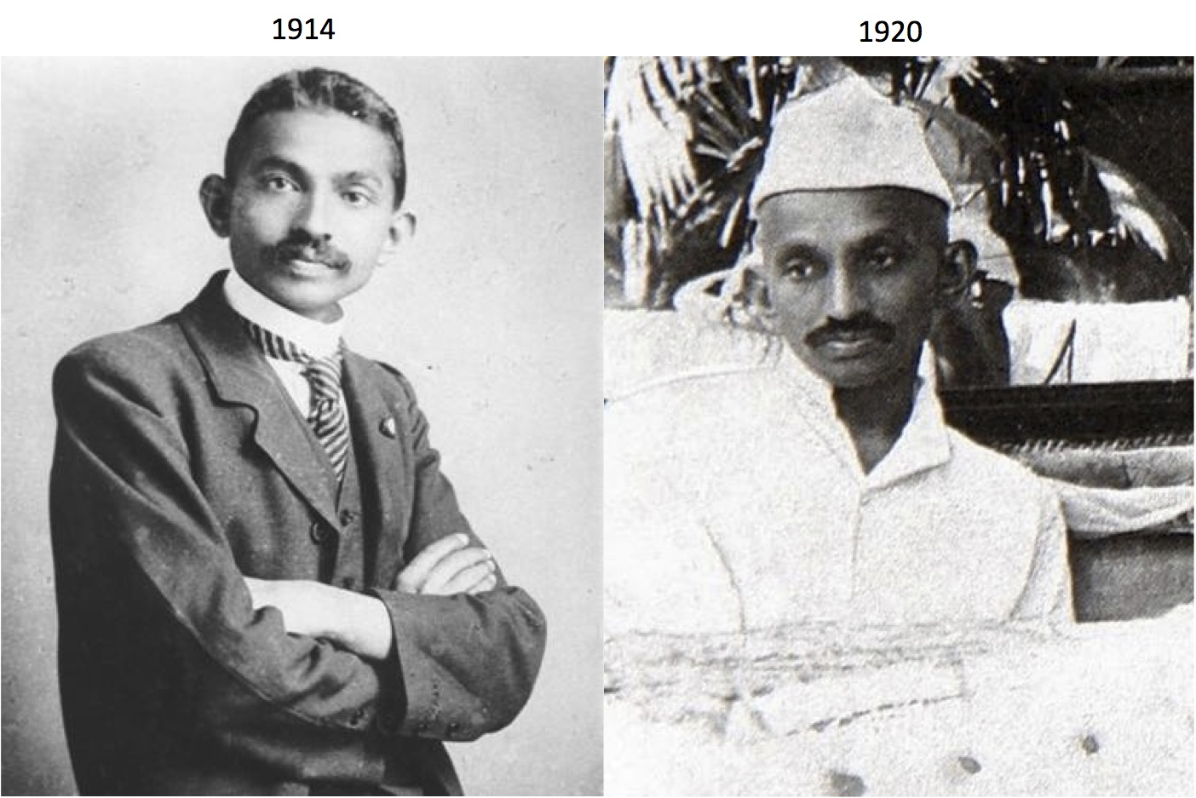

Slide 12
Google Trend Map

Slide 13
Google Trend

Slide 14
Biomass Distribution of MegaFauna
Livestock
Livestock
Livestock
Livestock
Livestock
Livestock
Livestock
Livestock
Livestock
Human
Human
Wild
Animals
Human
Human
Wild Animals
Wild Animals
10K-100K yrs ago
1970
Today
Source: Calculated from Anthony Barnosky, Proceedings of the National Academy of Sciences, Aug. 2008 and WWF Living Planet Index, 2015

Slide 15
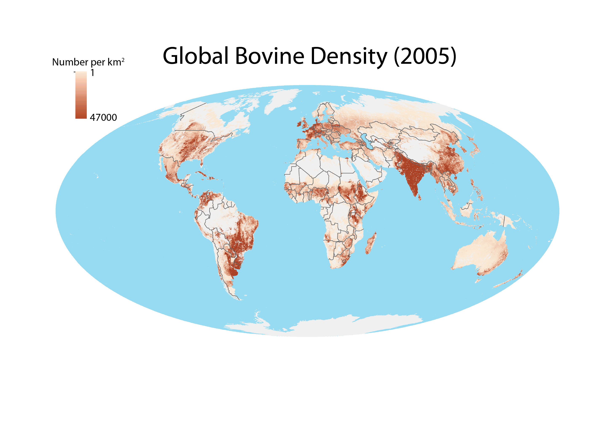

Slide 16
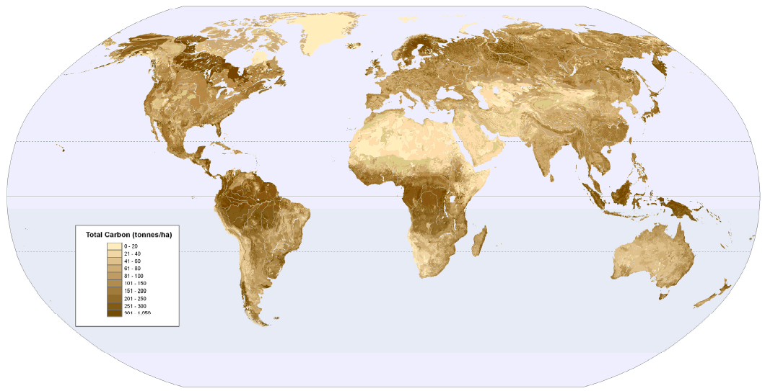
Global Land Carbon Stock

Slide 17
Source: IPCC AR5 WG3 Ch11, Fig.11.9, pg.836
TRADE
LAND
PRODUCTION
CONSUMPTION
Unused - Natural - Regenerating 26 MKm²
Unused Forests 11 MKm²
3.87
Livestock Production
(7.27 Gt)
2.18
3.14
0.26
0.26
0.14
Grazing Land 46 MKm²
3.87
1.52
Food Production
(1.78 Gt)
1.28
Food Intake
(1.54 Gt)
0.61
0.43
0.26
0.26
0.50
Forestry 30 MKm²
1.94
1.19
BioEnergy Production
(2.04 Gt)
2.04
BioEnergy Used
(2.04 Gt)
0.43
Urban 2 MKm²
0.28
Cropland 13 MKm²
5.69
0.14
0.67
0.75
Other Industries
(1.36 Gt)
0.99
Materials
(0.99 Gt)
0.23
4.02
Cropland Fallows 2 MKm²
0.47
0.87
0.14
0.37
Flow Values in Giga tons Dry Matter Biomass/yr
Crops and Residues
Animal Raw Products
Forestry Products
Waste Flows and Residues
Grazing and Hay
Final Products
Fuel wood from non Forests

Slide 18
Source: Rao, Jain and Shu, AGU Fall Meeting, Dec 2015.
TRADE
LAND
PRODUCTION
CONSUMPTION
Unused - Natural - Regenerating 26 MKm²
Unused Forests 11 MKm²
Unused Forests 57 MKm²
Grazing Land 46 MKm²
Food Production
(1.78 Gt)
1.28
Food Intake
(1.54 Gt)
0.61
2.04
0.26
0.76
0.78
Forestry 30 MKm²
1.94
1.19
BioEnergy Production
(2.04 Gt)
2.04
BioEnergy Used
(2.04 Gt)
0.57
Urban 2 MKm²
0.28
1.72
Cropland 13 MKm²
3.62
0.67
Other Industries
(1.36 Gt)
0.99
Materials
(0.99 Gt)
0.23
Cropland Fallows 2 MKm²
0.75
0.87
0.75
0.51
Flow Values in Giga tons Dry Matter Biomass/yr
Crops and Residues
Forestry Products
Waste Flows and Residues
Grazing and Hay
Final Products

Slide 19
The Integrated Science Assessment Model (ISAM)
2002

Slide 20
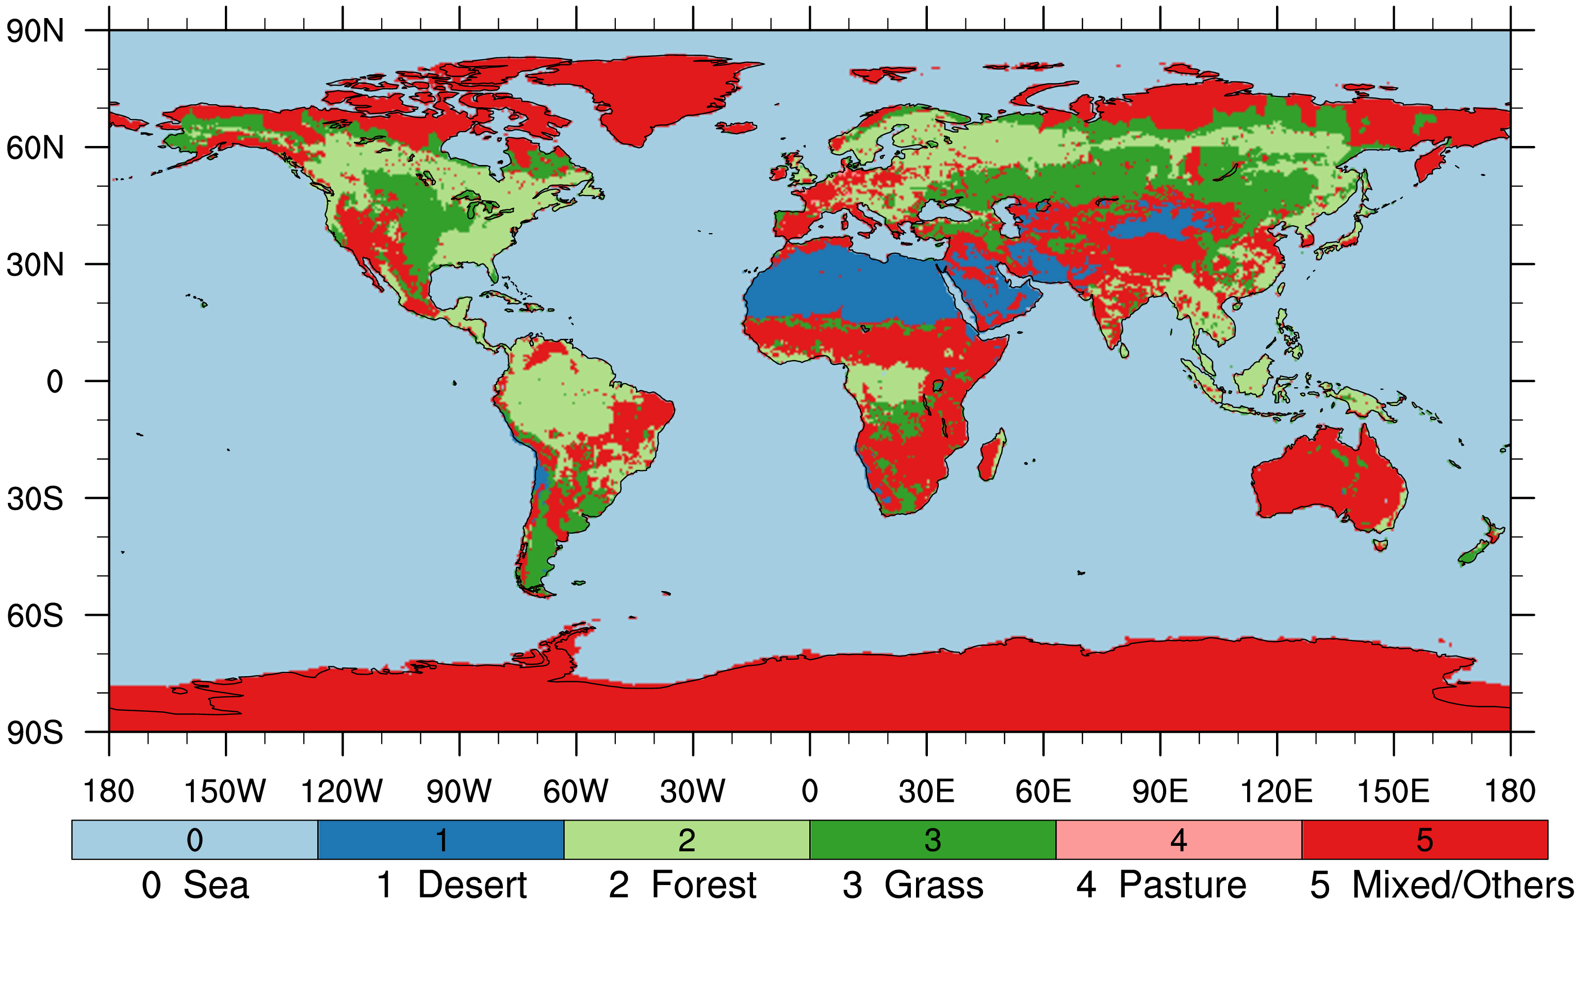
Land Use Map of the World (1800)
2002
Source: History Database of the Global Environment (HYDE) Land Use Data maintained by the Netherlands Environmental Agency

Slide 21
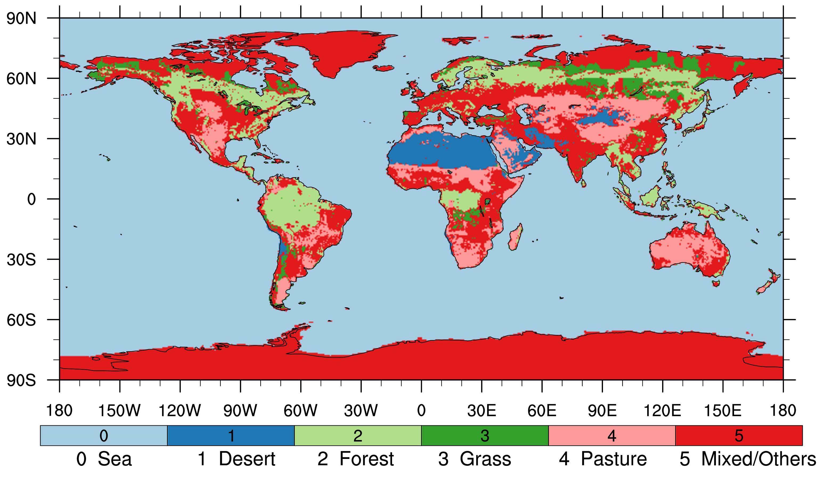
Land Use Map of the World (2014)
2002

Slide 22
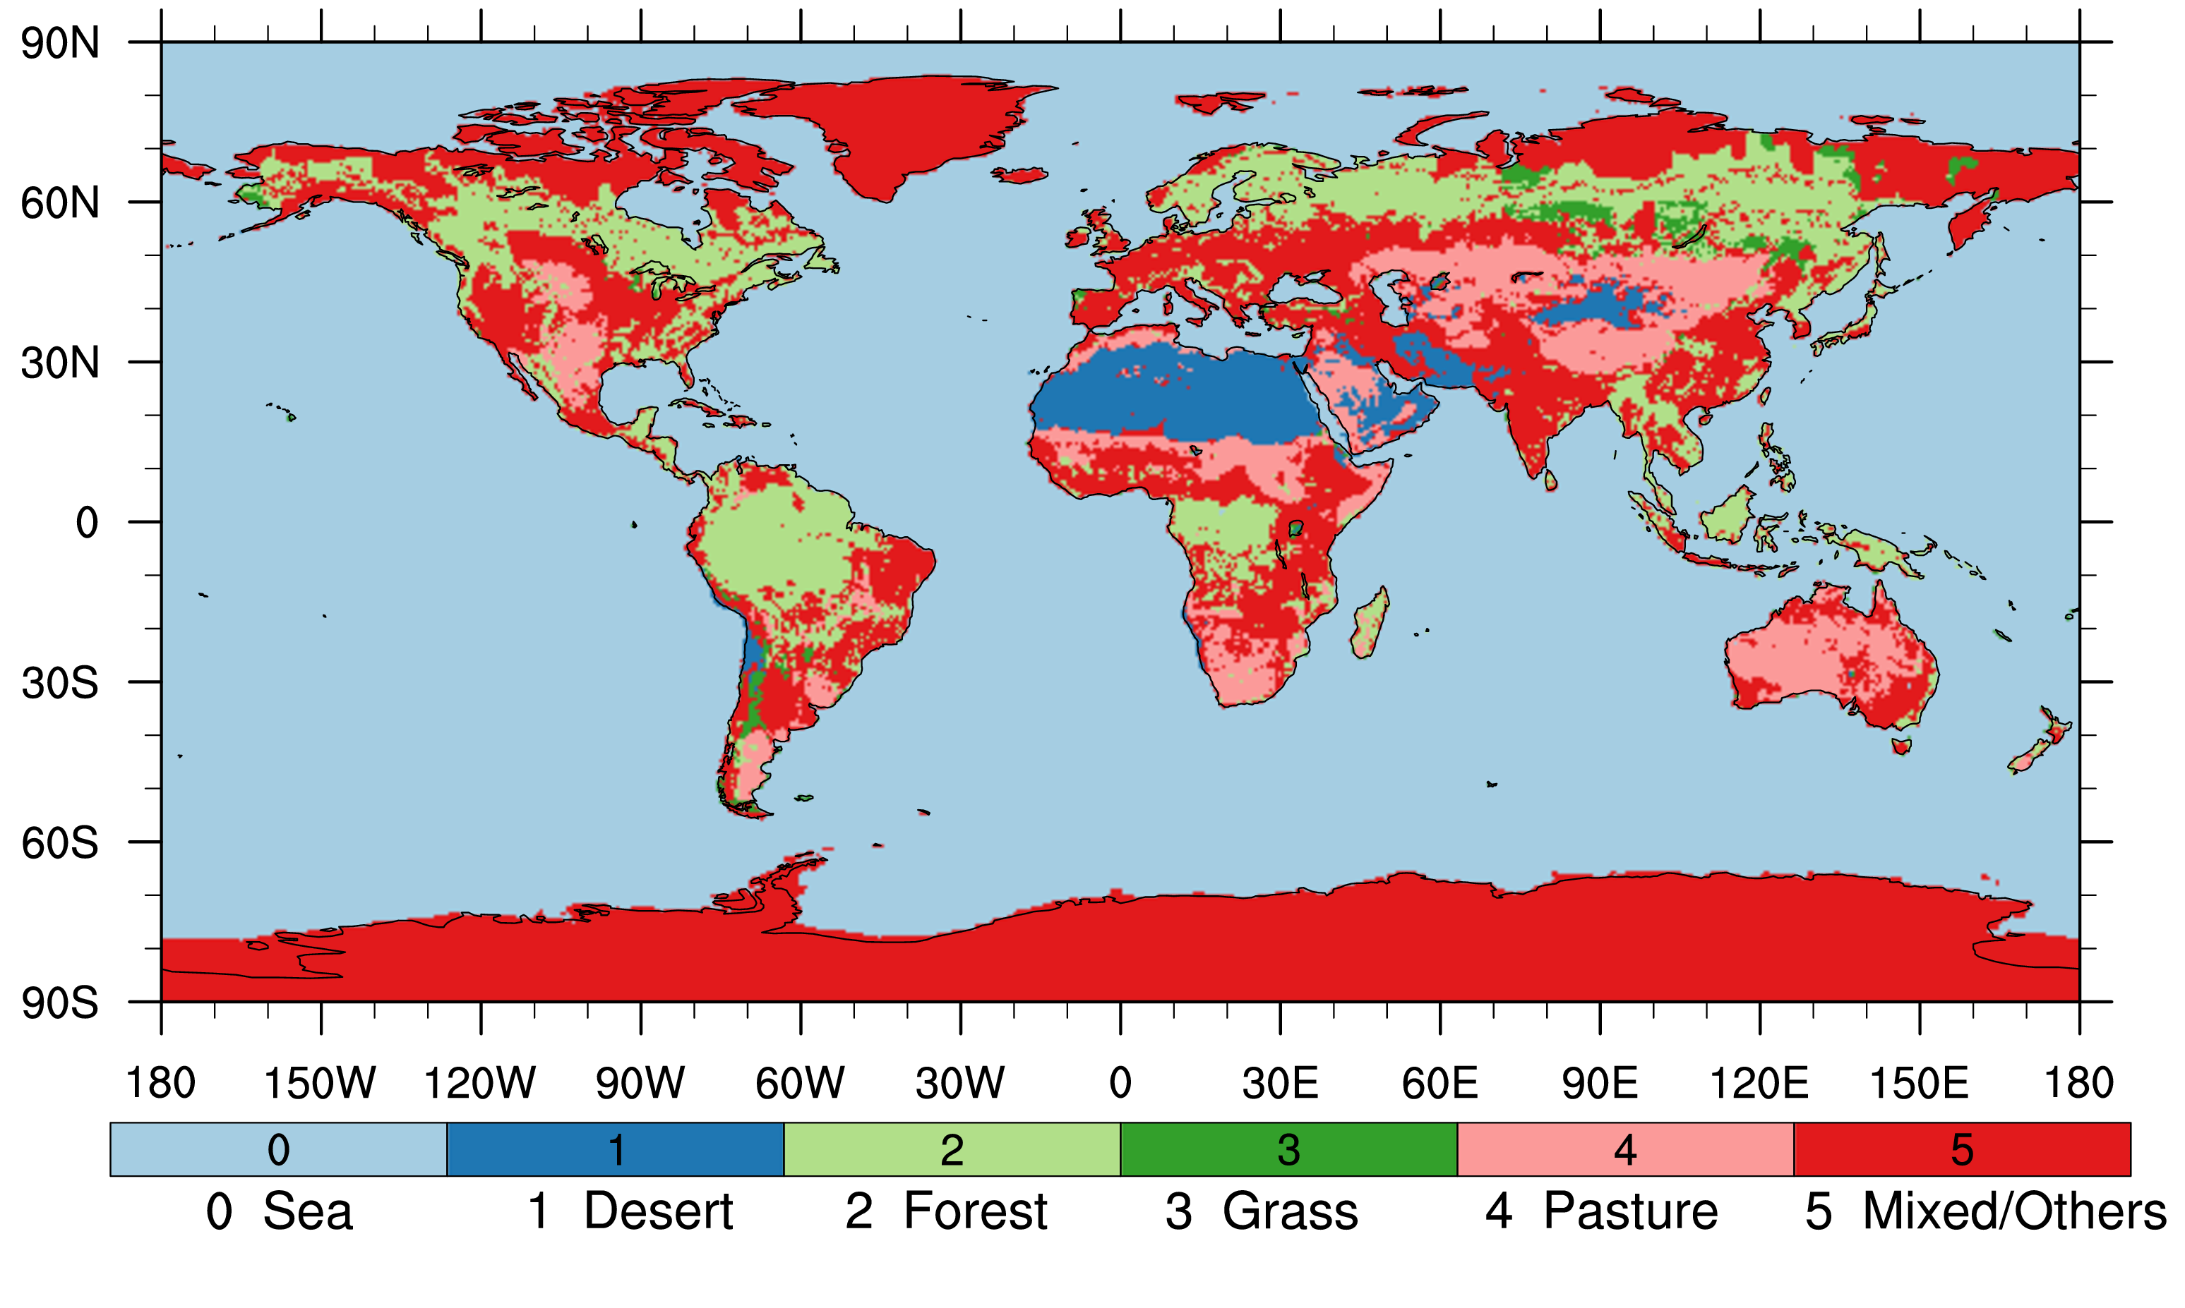
Land Use Map of the World (20XX)
2002

Slide 23
Net Primary Productivity Change Map
2002

Slide 24
Carbon Sequestration at Maturity
265 GtC can be sequestered on just 19.6 MKm² of grasslands and pasture lands reverted to native forests.
This is greater than the 240 GtC added to the Earth’s atmosphere since 1750!
2002

Slide 25
Details of the ISAM Estimation
Total Area of Grasslands/Pasture lands at present:
Carbon sequestration in such lands at present:
Total Area of such lands reverted to forest biomes:
Carbon sequestration in reverted lands at present:
Carbon sequestration in reverted forest biomes at maturity:
Net carbon sequestration at forest maturity:
Net carbon sequestration at forest maturity per unit area:
Estimated above ground re-growth over 20 years (Silver et al¹):
47.3 MKm²
52.8 GtC
19.6 MKm²
27.5 GtC
292.7 GtC
265.2 GtC
13.6 KgC/m²
617 gC/m²/yr * 20 yrs = 12.3 KgC/m²
2002
¹Silver, W.L., Ostertag, R., and Lugo, A. E., “The Potential for Carbon Sequestration through Reforestation of Abandoned Tropical Agricultural and Pasture Lands, Restoration Ecology, Vol 8, Issue 4, Pages 394-407,Dec. 2000.
Contact for Authors:
Sailesh K. Rao srao@climatehealers.org +1-(732)-809-3526
Atul K. Jain jain1@illinois.edu +1-(217)-333-2128
Shijie Shu sshu3@illinois.edu +1-(217)-721-3092

Slide 26
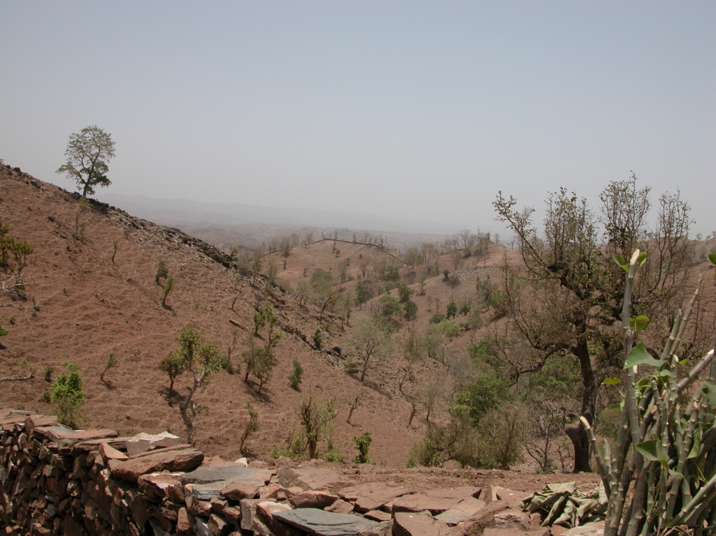
Courtesy, the Karech Village Forest Protection Committee and the Foundation for Ecological Security
2002

Slide 27
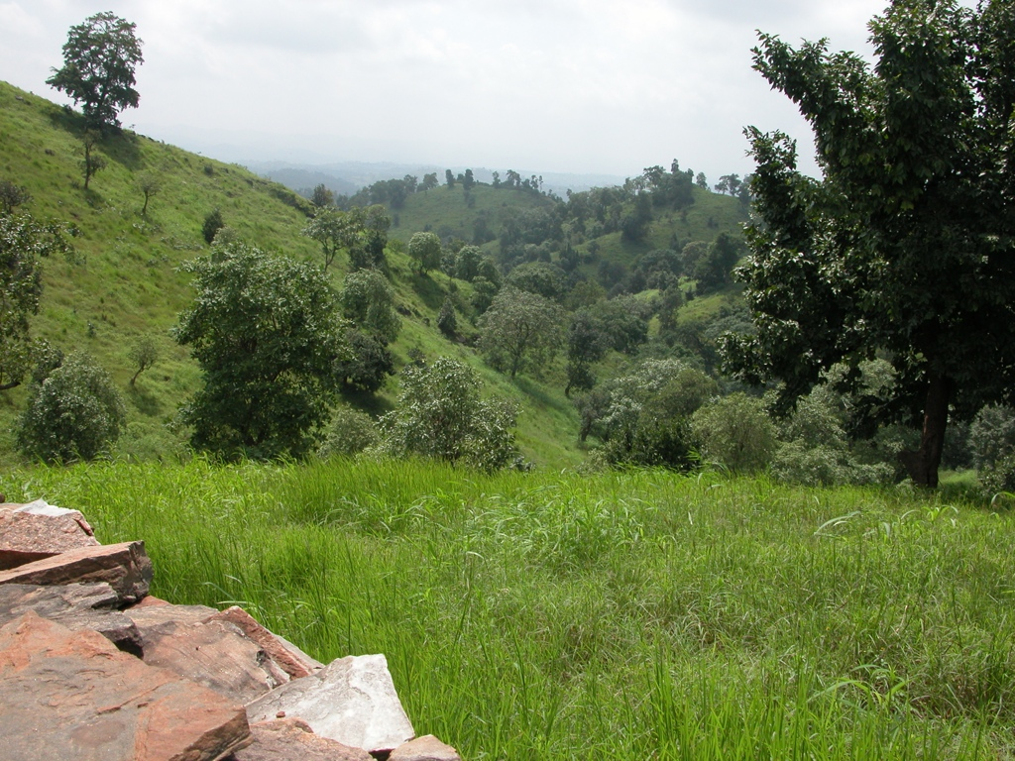
Courtesy, the Karech Village Forest Protection Committee and the Foundation for Ecological Security
2006

