Slide 1
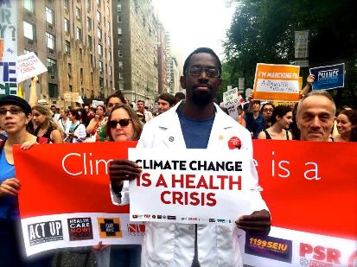
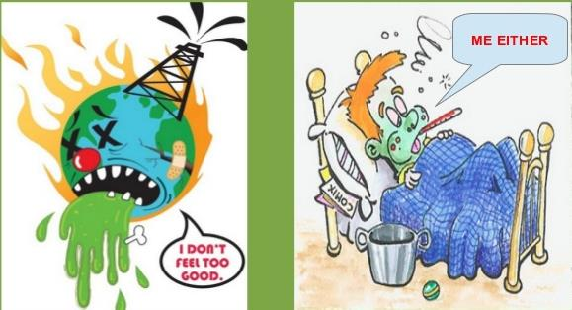
Climate Change Is Sickening
Maureen McCue MD PhD
Coordinator Iowa PSR
&
University of Iowa
Global Health Studies/Human Rights
Notes:
1

Slide 2
Discussion Goals—an outline of sorts
Who is in the audience, what are their interests, backgrounds? Climate Change Personal Meanings
Review/overview state of climate
Review/overview selection of health concerns
Whither the future? What can be done?
Open Discussion

Slide 3
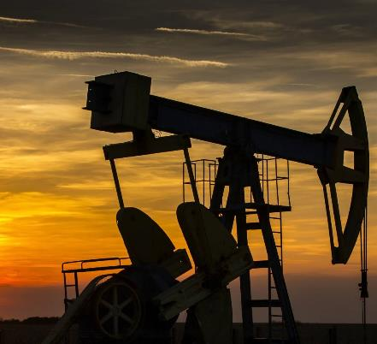
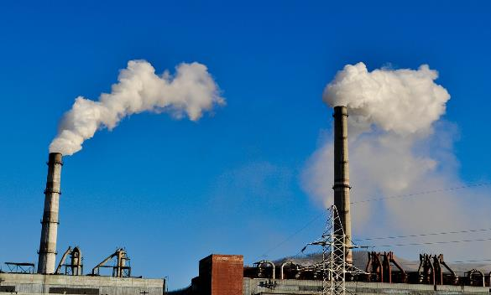
Current: Energy and Fossil Fuels
In 2014, ~ 67% of U.S. electricity still came from fossil fuels
Globally, around 80% of electricity comes from fossil fuels
But, 1.3 billion people still lack access to electricity & seek it
Notes:
Like in health, reducing unhealthy activity is an important first step. Energy efficiency reduces the demand for electricity, which under our current system means reducing the need to burn fossil fuels. In 2014, about 67% of US electricity came from fossil fuels. Globally, around 80% of electricity is generated from fossil fuels. This means that when you turn on the light switch, a large majority of the electricity is from coal or natural gas. Therefore, the less electricity we use, the less we need to burn in the first place.

Slide 4
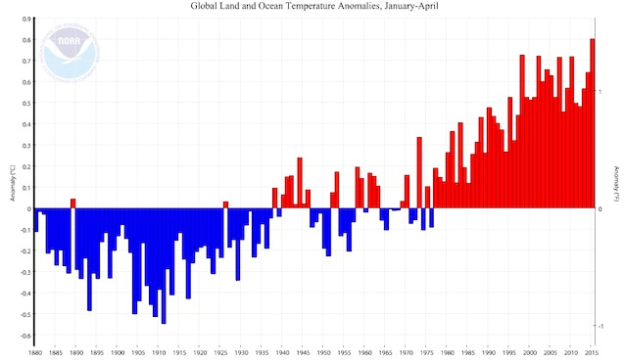
Hot is the New Normal
The last time the world saw colder-than-average temperatures across the globe was 1976.
Notes:
According to NASA, 2010 is on course to be the planet's hottest year since records started in 1880. The current top 10, in descending order, are: 2010, 2005, 1998, 2003, 2002, 2006, 2009 2007, 2004, and 2012.

Slide 5
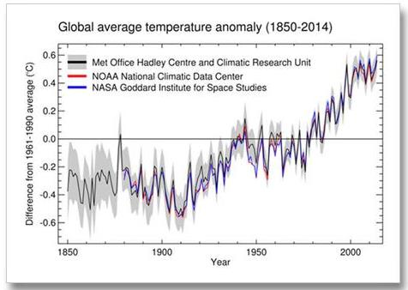
Earth has been warming approximately 0.2 ° C (0.36° Fahrenheit)/ decade for the past 60 years. NASA
Notes:
5
This rapid warming has brought global temperature to within about one 1° C (1.8° F) of the maximum temperature of the past million years. The last time it was that warm was about three million years ago, when sea level was estimated to have been about 25 meters (80 feet) higher than today."

Slide 6
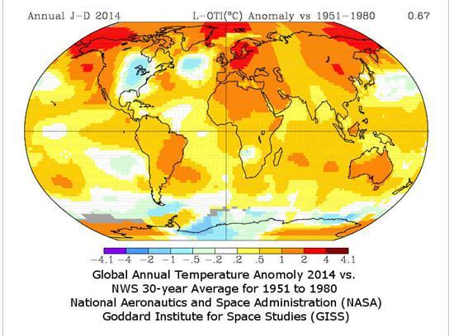
2015 Hottest Year on Record January 2016 Hottest January on Record
Climate change is real:
Greenland Ice Sheet is melting, sea levels are rising.
20 warmest years
in recorded history
occurred since1981.
10 in the past 12 years.

Slide 7
Terms… Global Warming -or- Global Climate Change?
Global warming = descriptive term regarding the increase in the average temperature of the Earth's near-surface air & oceans in recent decades and its projected continuation.
Climate Change – major changes in climate (temperature, rainfall, snow, or wind patterns) lasting for decades or longer as a result of the earth’s warming.
Climate Chaos or Climate Weirding: jumping back & forth between weather extremes
Climate shocks (climate extremes, extreme weather events):
Rapid onset: floods, storms, wave surges, rainfall-induced landslides, hailstorms, frost, scrub fires;
Slow onset: agricultural/meteroological/hydrological drought, heat waves
Some shocks are biologically induced but compounded by climactic factors (pest infestations, water-borne or vector borne diseases
Climate stresses: persistent occurrence of lower-intensity damaging events (soil erosion, degradation of coastal ecosystems, salinization of soils & groundwater, glacial melt, soil evaporation, ocean acidification, species migration, sea level rise)
Climate Hazards: result in losses and damages to livelihood systems. Composed of both shocks & stresses
Notes:
7
What do we mean? What should we say? We tend to use them interchangably [read slide]
Variability means both between and within seasons-- intra-season variability seen as extreme variability in daily rainfall and temperature, even if averages are stable. Given this, some even prefer the term "weather wierding," because the rise in average global temperature is going to lead to all sorts of crazy things - from hotter heat spells and droughts in some places, to colder cold spells and more violent storms, etc. in other places.

Slide 8
Examples: ….. From Degrees to Deaths
Europe 2003, ~20,000 people died due to extremely hot temperatures.
July 2010 Russian Heat Wave killed 55,000
June 2013 a ferocious flood, the result of changing hydrological conditions in the Indian Himalaya, killed ~30,000 people
May 2015 sustained heat wave w/ highest recorded temps since 1995 caused deaths of >2,500 people in multiple regions India.
Feb 2016 Cyclone Winston, 1st Cat. 5 tropical cyclone ever to hit Fiji; earlier that day, became strongest tropical cyclone of record in Southern Hemisphere w/ maximum winds peaking at 185 mph
Notes:
8
Small- and medium-scale disasters are occurring more frequently than the kind of large-scale disasters that hit the headlines. Floods, droughts and melting ice caps are each associated with increased suffering, death, and disease.
In Europe in 2003, an estimated 20,000 people died due to extremely hot temperatures. The situation will worsen if climate trends continue. A further 5.5 million healthy years of life were lost worldwide due to debilitating diseases caused by climate change. WHO scientists note "We see an approximate doubling in deaths and in the burden in healthy life years lost" by 2030.
Large cities are also likely to experience more severe health problems because they produce the urban "heat island" effect.

Slide 9
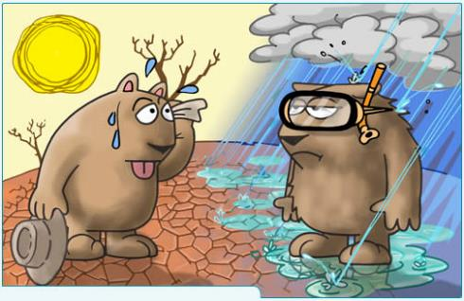
Global Warming: Not Just an Increase in Warmer Weather
● Altered rainfall patterns
● Marked ↑s in extreme weather events - in intensity & frequency—
(Heat, Drought, Fires, Violent Storms)
● Sea Level Rise & ↑ Acidity, Salinity
Degraded ecosystems:
loss of many species plant & animal
migration of others in altitude & latitude
↑d plant/insect pests & disease vectors
Climate change will change life on Earth: will affect
all nations, all plants, all animals, all humans, all living beings!
…we are the first generation to feel the impacts of climate change, and the last generation that can do something about it! President Obama
Notes:
Ex: Global Warming means…(discuss)
Examples:
-- Extremely costly Hurricanes will become more intense due to global warming. Insured losses caused by hurricanes in 2004 & 2005 in Florida alone Cost $35 billion.
-- Global warming effects can also be seen in the rise in sea level with simultaneous loss of surface river water flows. The best estimate is that sea level will rise about 19 inches in this century (1-3 feet in the next 100 years), primarily due to expanding warmer ocean water even if global greenhouse emissions are stabilized and of course more if we don’t reduce our emissions. Sea level is rising because of expansion of warmer ocean water (thermal expansion) and melting of polar and glacial ice. Glacier melt in the Himalayas is projected to increase flooding, and rock avalanches from destabilized slopes, and to affect water resources within the next two to three decades to be followed by decreased river flows as the glaciers recede. For North America, warming in western mountains is projected to cause decreased snowpack, more winter flooding, and reduced summer flows, exacerbating competition for over-allocated water resources.
--the loss of biodiversity is related to loss of natural habitat areas which are shrinking, putting many species of plants and animals at risk (including up to 30% of bird populations—many of which are not currently on any endangered lists).
--An increase in disease is predicted to occur on a global scale in association with a simultaneous increase in weed and pest populations.

Slide 10
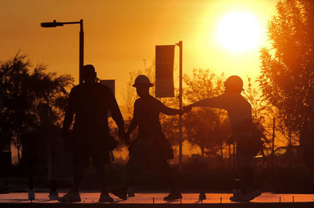
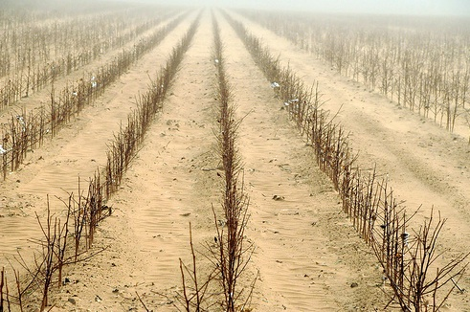
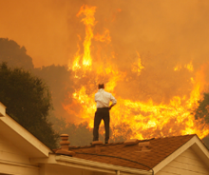
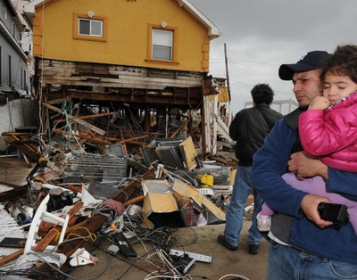
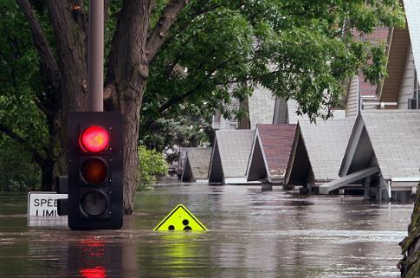
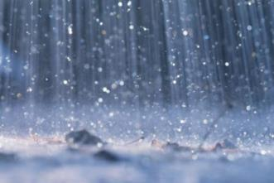
Thus far, drought = the most harmful climate effect to people
Heat
Drought
Deluges &
Floods
Violent Storms
Sickening Climate Change

Slide 11
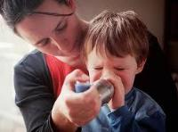
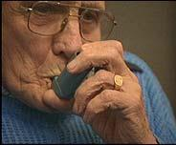
Impacts Before, During, After Extreme Weather
RETIRING ONE DIRTY COAL-BURNING PLANT WILL PREVENT:
Over 29 premature deaths
47 heart attacks
491 asthma attacks
22 asthma emergency room visits¹
Note: ¹Numbers are per year from the Clean Air Task Force

Slide 12
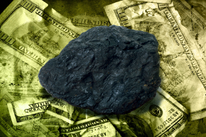
Externalized Fossil Fuel Energy $ Costs $ Costs of inaction: high & rising!
Economic, health & environmental costs associated w/ coal, other dirty fuels: > half a trillion $$/yr.
Society could save many millions/yr in health care costs by simply reducing electricity generated from coal*
*Epstein, P. R et al (2011) Full Cost Accounting; EPA’s COBRA Modeling

Slide 13
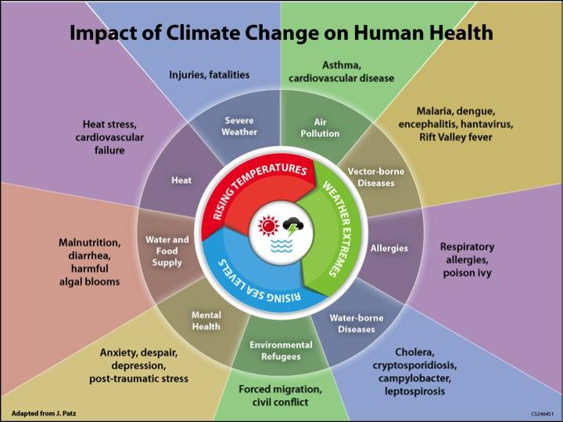
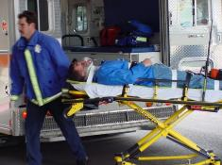
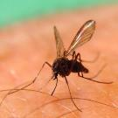
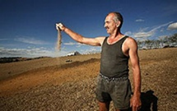
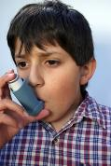
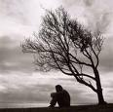
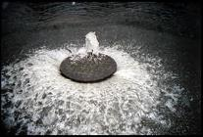
Hunger

Slide 14
Factsheets
Reports
Videos
Climate Change and Health:
The Effects of Heat
Climate Change Contaminates Your Water
Insect Borne Diseases
Wildfires
Storms and Sea Level
Conflict
Famine
Vulnerable Populations
Climate Change is a Threat to Health: More Heat, More Ozone
Death by Degrees (multiple state specific reports begun in 2000)
Coal Mapping Report
Climate & Contagion
Climate & Conflict
Climate & Food
What you Can Do
Brochures

Slide 15
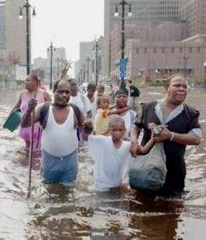
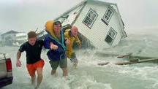
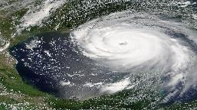
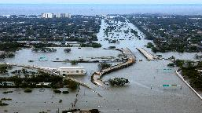
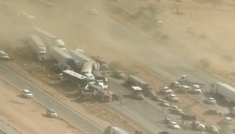
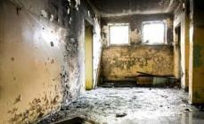
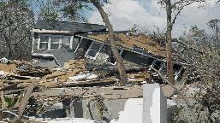
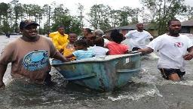
Summary Extreme Weather Events & Disasters
Weather, climate and water-related disasters are all on the rise worldwide
1970-2012: 8,835 disasters, 1.94 million deaths, US$ 2.4 trillion of economic losses globally
Over 300,000 lives/year are lost from extreme weather, famine, fire, floods, declining air quality, and spreading tropical diseases….greatest impact on poor countries, marginalized
Traumatic injury, illness, mental and emotional distress follow disasters
Children: more persistent psychological symptoms than adults experiencing same disaster
PTSD, sleep disturbance, aggressive behavior, sadness and substance use/abuse all increase
Notes:
CHILDREN WHO FEEL THEY ARE GOWING UP IN A THREATENED FUTURE TEND TO BE MORE TROUBLES THAN THEIR PARENTS AND GRANDPARENTS. A SURVEY OF AUSTRALIAN CHILDREN INDICATED THAT A QUARTER OF THEM FEAR THE WORLD WILL END BEFORE THEY GROW UP.
KATRINA-1.1 MILLION PEOPLE DISPLACED, 1,833 DEAD, 270,000 HOMES LOST, $200 BILLION IN TAXPAYER DOLLARS
SUPER STORM SANDY-150 KILLED
THINK FUKUSHIMA, THINK NEPAL
A STUDY DONE BY THE WOODS INSTITUTE FOR THE ENVIRONMENT IN 2013 FOUND THAT THE MAJORITY OF THE PUBLIC BELIEVES THAT GLOBAL WARMING IS HAPPENING AND 83% SUPPORT PREPARING NOW FOR THE COMING IMPACTS……

Slide 16
Most Vulnerable to Effects of Changing Climate
Babies & Children
Elders
Pregnant women
Outdoor workers
Disabled & People w/ pre-existing conditions (asthma, lung and heart dx, diabetes)
Impoverished, racial & ethnic minorities anywhere (ex: across US high % of AAs live close to a coal plant or oil refinery)

Slide 17
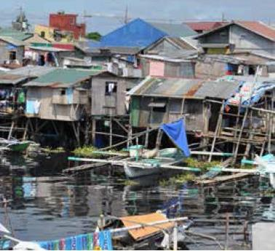
Most Vulnerable: at extreme ends of life, impoverished
Informal Settlements Risk Flooding

Slide 18
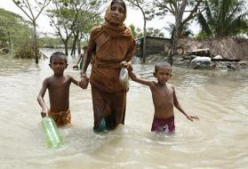
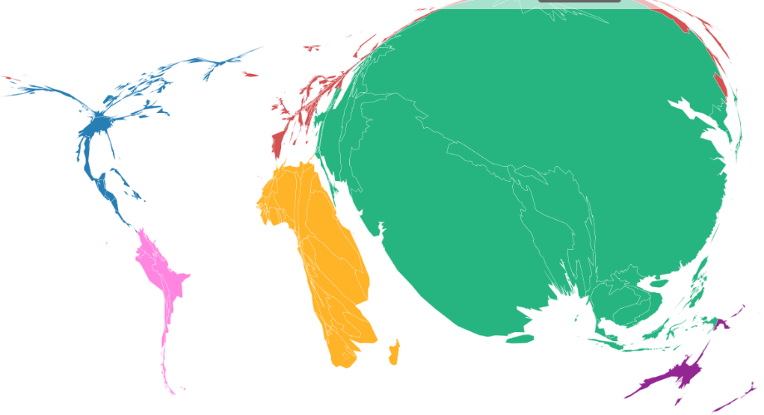
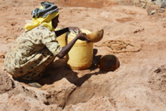
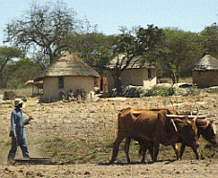
Persons Most Affected by Climate Induced Disasters
KILN Carbon Map 2013
90% of those affected are not those emitting GHGs in large quantities

Slide 19
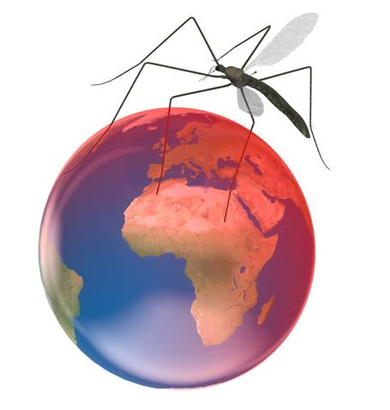
An Now Comes Zika!
What Zika Teaches Us About Climate Change
There is much we don’t yet know. This outbreak came as a surprise--expect to be surprised again as climate disruption interacts w/ globalization & deforestation to alter the ecology of vector borne diseases.
Climate Change is a Justice issue. Climate disruption isn’t fair. Climate change will harm poor communities worst, first. As climate disruption fuels other infections, expect to see a similar impact pattern. Transmission is hard to break in areas w/out window screens, air conditioning, paved streets, running water, mosquito control programs, disease monitoring systems.
Unintended consequences. Massive campaigns in dozens of countries are killing mosquitoes w/insecticides exposing millions of people, forests, waterways, other animals to insecticides—with what eventual impacts? Will rare but serious health impacts emerge from industrial chemicals deployed on a massive scale? How do we weigh benefits against potential unintended consequences in future outbreaks?
Importance of international cooperation. Dozens of countries must coordinate w/in a global public health infrastructure to effectively respond to a fast moving epidemic potentially unleashed by a changing environment.
Zika as opportunity. News-watching woman of childbearing age, public health professionals, travelers worry and wonder what to do. The Zika epidemic is an opportunity to dedicate resources to prepare for the health impacts of other vector-borne diseases in a changing climate. To avoid being blindsided by the next outbreak, we must invest in detection, monitoring, response planning.
Zika is a dry run for the future

Slide 20
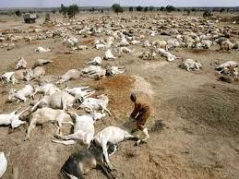
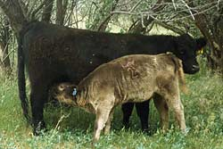
People, animals and Plants at Risk
Beyond concerns for people living in climate impacted flood or drought areas containing unhealthy levels of soot (NOx & SO₂) or smog (NOx & VOCs), health providers & scientists have:
Related Concerns: Extreme weather, smog, pollution reduce livestock & crop productivity, weaken plant growth and defenses, making them also vulnerable to insects & diseases, and increased rates of livestock mortality--ex. Think Aflatoxin.

Slide 21
Other Important Impacts You May Have Overlooked!
Climate affects the flavors and types of hops available for your favorite beer; the grapes for the best wines!
EDF

Slide 22
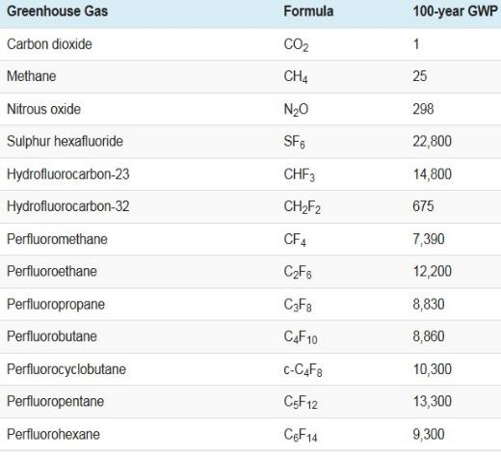
Green House Gas Equivalents (CO_{2e})
100-year global warming potential for GHGs reported by the United Nations Framework Convention on Climate Change
Not all GHGs are created equal.
Some are in small quantities, & relatively short acting, but
Some, ex: Methane (Natural Gas, garbage, CAFOs), N₂O (fertilizers), HFCs (refrigerants) are released from multiple sites & much more powerful than CO₂
From 4th Assessment IPCC 2007

Slide 23
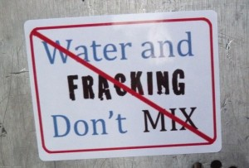
Fracking Concerns What We Don’t Know But Highly Suspect
Citizens of towns being “fracked”, grassroots coalitions, social media campaigns, EPA, and increasing numbers of health & environmental professionals have for years insisted fracking is a dangerous, poorly-regulated process w/ potential to contaminate land, ground water and air, and sicken people in the vicinity. Fracking has not been proven to be safe from several perspectives:
There are unknown, poorly controlled quantities of Methane (CH₄) leaks at Frack sites -- at least 6% of fracking wells leak immediately; 50% of conventional oil and gas wells leak w/in 30 years – but fracking hasn’t been around long enough for this kind of data to exist for fracking wells, although evidence is moving in this direction;
Leaking wells lead to a risk of water contamination while diverting millions of gallons of fresh water in the process;
Lack of transparency, given protection of “Industrial Secrets,” of the contaminant chemicals and associated risks are unknown -- inpatient hospitalizations, & self-reports of, skin, respiratory challenges increased near frack sites;
Fracking wells affect near-by home values;
Mining for Frack Sand (IA & WI) requires removal of climate protective trees & greenery, releases dust & particulate matter, reduces health and safety of near-by communities.

Slide 24
Iowa’s Good News Experience to date: Wind = 28.5% Electricity Generated w/ NO Pollutants
$10 Billion in Capital Investment in Iowa’s wind industry
5,708 MW Wind Energy installed by end of 2014 (by 2014 Iowa’s wind industry offset 9.2 metric tons of CO₂ = removing ~1,600,000 cars off roads as well as saving >3.2 billion gals H₂O/yr)
3,198 Utility Scale Turbines w/ 98 projects on line producing energy
14 manufacturers turbines/blades; 75 wind-related companies
6,000-7,000 employed in all wind related activities
Landowners lease payments = $17.1 million/yr.
Iowa’s electric rates are lower than the national average = WIN, WIN

Slide 25
Iowa’s Potential: We’ve only just begun!
75% of Iowa suitable for Wind Energy Development
Estimated total resources = 570,000 MW of wind energy
Wind power is capable of meeting > 44x the state’s current electricity needs
Current goal is 6,300 MW by end of 2015 (~3 coal fired power plants); then 20,000 MW by 2030
Re. Intermittancy: The more wind turbines installed, the less additional variability there is in the amount of power that they produce. (contrast w/ abrupt failures of conventional power plants & sudden loss large amts. power)
Additionally, ea. MW hour of wind generation prevents the loss of up to 600 gal. of H₂O from fossil fuel power plant cooling

Slide 26
And then there’s Iowa’s Solar Potential
The potential for 100% solar energy in Iowa requires a relatively tiny footprint—
rooftops alone could provide 20%!
Source: Real Potential, Ready Today: Solar Energy in Iowa. Iowa Environmental Council 2013

Slide 27
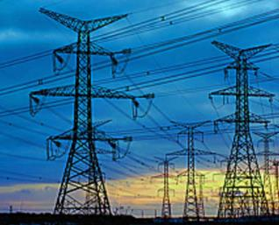
More Good News
Coal, Fossil Fuel Use in U.S. & Europe declining
Renewables around the world rising rapidly
Integration of many types of renewable energy resources w/ energy storage demand response in a smart grid can provide the flexibility needed to create a reliable low-carbon power supply

Slide 28
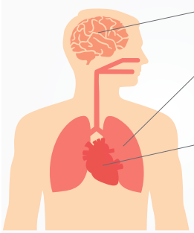
Remember: Health Benefits of Energy Efficiency
Less electricity used = less fossil or any fuel needed to burn. By displacing fossil fuels, energy efficiency reduces pollutants overall & improves public health.
Mercury exposure from fossil fuels can damage the brain and nervous system, leading to stroke or loss of intellectual capacity
Pollutants such as particulate matter and nitrogen oxides can harm the respiratory system and cause lung cancer, COPD, and asthma
Fossil fuels can also damage the cardiovascular system which can lead to coronary heart disease, heart attacks, or congestive heart failure
Image Source: ACEEE
Notes:
Multiple pollutants that come from burning coal cause serious harm to the body. Mercury exposure can damage the brain, leading to stroke or loss of intellectual capacity. Pollutants such as particulate matter and nitrogen oxides can harm the respiratory system and cause lung cancer, COPD, and asthma. Particulate matter and nitrogen oxides can damage the cardiovascular system, which can lead to coronary heart disease, heart attacks, or congestive heart failure. For our health, it is clearly beneficial to replace fossil fuels with more efficient technology. PSR and the American Council for an Energy-Efficiency Economy recently collaborated on this handout to highlight the health benefits of energy efficiency.

Slide 29
Remember:
Petroleum
Doesn’t Move
On it’s Own
Volition…
It Requires
Enabling….
Peddlers of
Doom!
This
Man-made
Problem can have
People Powered
and
Designed
Solutions

Slide 30
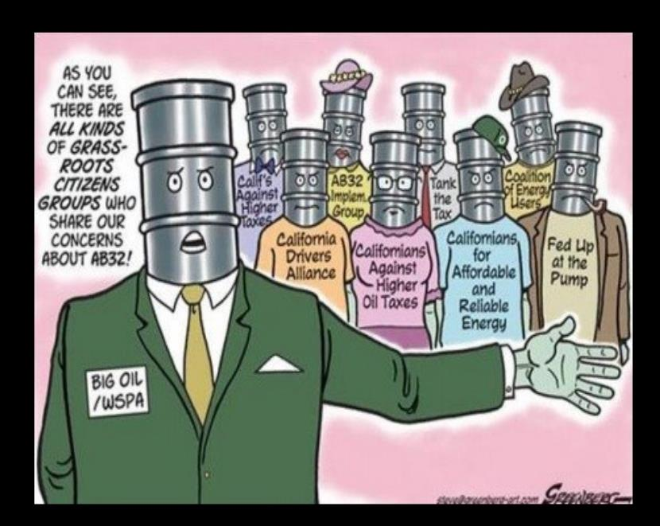
Don’t be Fooled by
Green Washers & Oil
Interests Disguised as
Grassroots Citizen Groups

Slide 31
Promote Real Homeland Security: Disaster Mitigation / Adaptation Planning
For Improved Climate Health and Security, we also need:
Better Surveillance, Monitoring, Prediction, Warning, &
Climate/Disaster Response Plans
Ex: Municipal Heat Wave Response Plans
Society wide adaptations - From Agriculture to Building Codes; Household Preparedness, Urban Planning; Alternative Energy Systems, Afforestation, Floodplain Zoning, Building Embankments, Restoration of Wetlands. All must be adapted to provide protection from storms, flooding, possible heat waves.
In short:
Pre-emptive Medicine: Justice, Climate Resilient Communities, Infrastructure & Development!
Modern Societies can Adapt to become More Resilient, Healthy & Secure!
Notes:
Domestically, the effects of climate change could overwhelm disaster-response capabilities. As was painfully evident in NOLA in the aftermath of Katrina, current health infrastructures and systems are completely unprepared for climate change. Internationally, as mentioned, climate change may cause humanitarian disasters, contribute to political violence, and undermine weak governments. Immediate actions are needed to improve the global public health infrastructure, the ability to fight disease, and improve access to health services, both across the U.S. and around the world.

Slide 32
Proof of Concept: Europe Wind Power Generates 140% of Denmark’s Electricity Demand - With Enough to share!
Interconnections allowed 80% of the power surplus to be shared w/ Germany & Norway, which can store it in hydropower systems for use later. Sweden took the remaining fifth of excess power.
It shows that a world powered 100% by renewable energy is possible; it can be a solution to decarbonisaton—with government backing. The guardian July 10, 2015

Slide 33
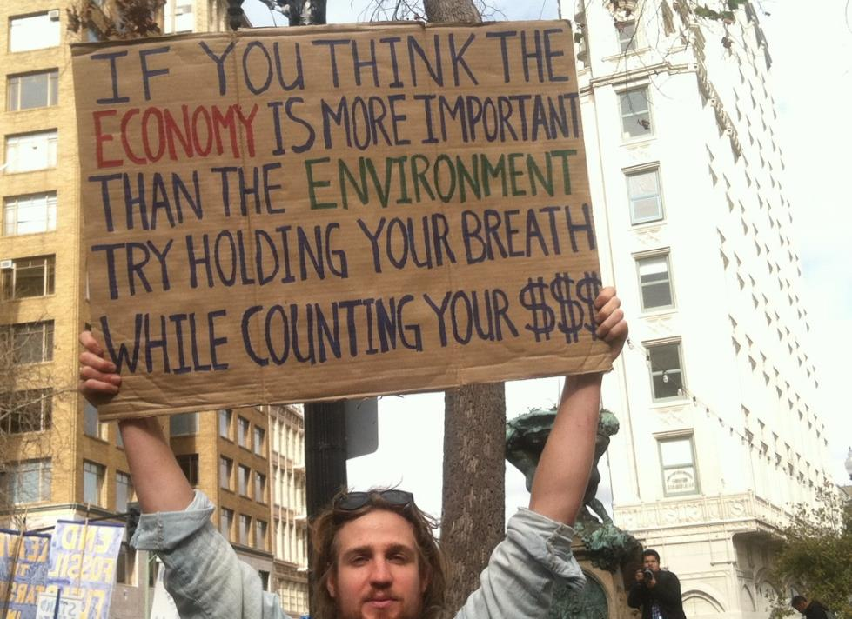

Slide 34
For all our Health:
Stop Financing Deadly Pollution
Leave Sickening Fossil Fuels in the ground—and thanks

Slide 35
Some Resources
Atlas of Mortality and Economic Losses from Weather, Climate and Water Extremes 2014 World Meteorological Organization
Forced Migration Report 2015
KILN Carbon Map 2014
Anatomy of a Silent Crisis. Global Humanitarian Forum. Geneva 2009

