Slide 1
Electric Cars: Save the Planet and Your Budget Too
Using green electricity (Iowa wind and solar) pollutes our planet much less than gasoline and reduces global warming.
A used Electric Vehicle (EV) is inexpensive to buy ($12-16,000),
operate (“gas” @ $1/gal) and maintain!
Pure electric cars have no muffler, oil, air filters or emissions controls. Extended range electric cars like the Chevy Volt have far less maintenance than a
comparable gas powered car.
Come ready to ask any question
about Electric Vehicles.
Marc Franke
Nissan LEAF owner
Pat Higby
Chevy Volt owner

Slide 2
Save the planet and your budget!
Planet | Budget
NO emissions or pollution with solar | Used ~ < $10k – 16k, low miles & wear
Low emissions w/Iowa wind (> 30% !) | Solar locked in price, eventually “free”
No pipeline/tanker spills | Gas $ volatile, electricity regulated
No Gulf coast drilling disasters | Grid electricity ~ $1/gal
No refinery explosions | Saves 2.5 ¢/mile @ 38 mpg & $2 gas
No Canada forest for Tar Sands oil | Almost NO maintenance; rotate tires!
No military to keep foreign oil flowing | LEAF battery: 100,000 mi./8 yr warranty
Less landfilled oil filters, mufflers, etc. | Battery replacement ~ $5500

Slide 3
Saving the planet … no oil
Oil – 60m yrs!
EV + PV
Solar “refinery”
cost $4,200
for 25 yrs of fuel

Slide 4
EVs just shift the emissions?
Union of
Concerned
Scientists
Iowa 2014 number is 55 mpg
CO2
from
grid
electricity
Solar
fuel is
zero
emissions!
Iowa numbers based on 2009 data
Wind was 14% … 30% now, headed to 40%!

Slide 5
Saving the planet … war for oil?
Military intervention to keep foreign oil flowing?
G.W. Bush Republican Alan Greenspan in 2007 memoir:
"the Iraq War is largely about oil." http://www.washingtonpost.com/wp-dyn/content/article/2007/09/16/AR2007091601287.html
The CBO estimated that of the $2.4 trillion long-term price tag for the war, about $1.9 trillion of that would be spent on Iraq, or $6,300 per U.S. citizen. https://en.wikipedia.org/wiki/Financial_cost_of_the_Iraq_War
Former CIA Director R. James Woolsey, Jr.
People used to fight wars over salt … until refrigeration
We must make oil non-strategic; no wars for oil https://www.youtube.com/watch?v=lklm19UxCog

Slide 6
Save your budget … used EVs
EVs like the Nissan LEAF and Chevy Volt
Coming off of 3-yr. leases (started in 2011)
Federal $7,500 rebate; already applied, lowering cost
LEAF is local driving only (EV range & recharge time)
Low miles & wear, no maintenance; perfect 2nd car!
Volt is extended range with gasoline back up generator
Volt drivers typically drive 75% of the time on battery
Used Volt gas engine has only 25% of the normal wear!
Gas $ very volatile, electricity cost is regulated ~ $1/gal

Slide 7
Energy price stability

Slide 8
Save your budget … fuel
EV costs (@ 3.6 mi./kwh & 10 cents/kwh) 2.8¢ /mi
Gas cost (@ 38 mpg & $2 gas) 5.3¢ /mi
Saves (@10,000 mi/yr & 2.5¢ /mi) $250/yr

Slide 9
Save your budget … maintenance
All-electric EVs (LEAF) … virtually no maintenance!
No: muffler, oil, oil filter, changes, air filter, fuel filter, starter, emissions controls, belts, spark plugs, wires, tune ups, pistons, rings, fuel injectors, transmission, etc.
Chevy Volt … 25% of a normal car’s maintenance
Less trips to the dealer/service station
“I noticed a problem while doing your oil change”
“You could let it go and be stranded, or fix it today …”
LEAF battery; 8 yr./100k mi. warranty, $5500 replace

Slide 10
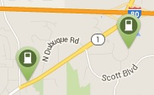
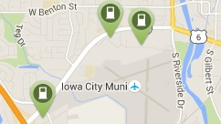
Charging: Iowa City 6 locations with 24 Level 2 stations total
Coralville:
UIHC parking deck (8!)
Inter-Modal transportation center (2 + 4!)
NE Iowa City: ACT (3)
HyVee N. Dodge (2+2)
South Iowa City: Van Meter
Nissan dealer
Chevy dealer
North Liberty: - Coming 2016 -
New HyVee (4?)
North of Coralridge Mall

Slide 11
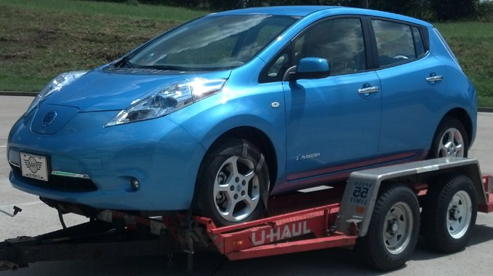
Used LEAF ~ 100 within 200 mi.
Autotrader.com, 3/20/16
2011, 35k mi., $8,400, Chicago
2012, 45k mi., $9,000, Chicago
2013, 17k mi., $9,400, Chicago
2014, 25k mi., $16,000, Peoria
How do I get a “local range” LEAF home?
Towed or hauled

Slide 12
Used Volt ~ 302 within 200 mi.
Autotrader.com, 3/20/16
2012, 52k mi. $13,000, Cedar Falls
2013, 57k mi., $12,000, Chicago
2014, 102k mi., $12,000, Chicago
2013, 35k mi., $15,000, Naperville (Chicago)
How do I get a used Volt home?
You just drive it! It has the extended range generator.

Slide 13
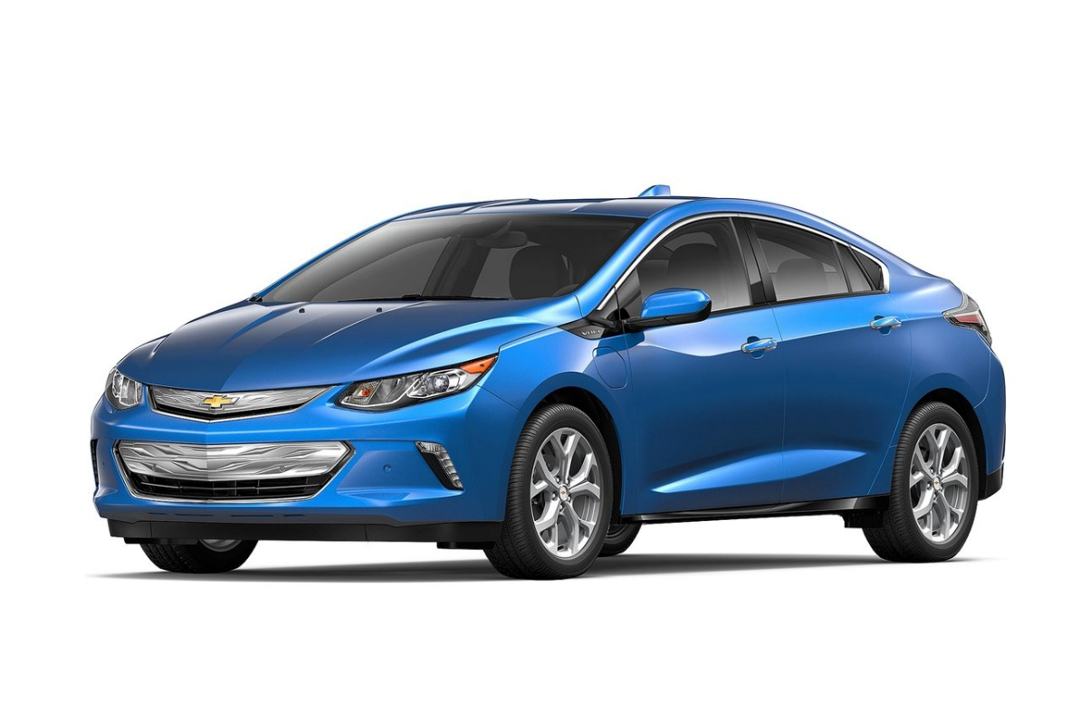
New EVs you can buy in 2016
2016 Nissan LEAF All electric, 107 mile range
$35,050 (SV trim)
+ $7,500 Federal tax rebate
2016 Chevy Volt
53 mile EV range
43 mpg gas backup
“Extended range” EV
$34,455 (LT trim)

Slide 14
What’s it like to drive an EV?
Pat Higby – Chevy Volt
Marc Franke – Nissan LEAF
Experience?
Comfort?
Range?
Winter driving? Winter range on electricity?
How’s the heater?
Do you like it? Would you buy another?
What’s it like to make your own solar “fuel”?

Slide 15
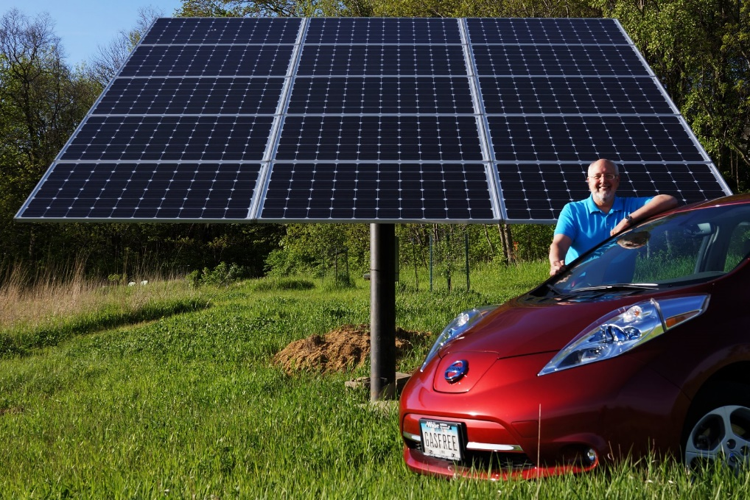
The End … er, the beginning?

